Slide 1
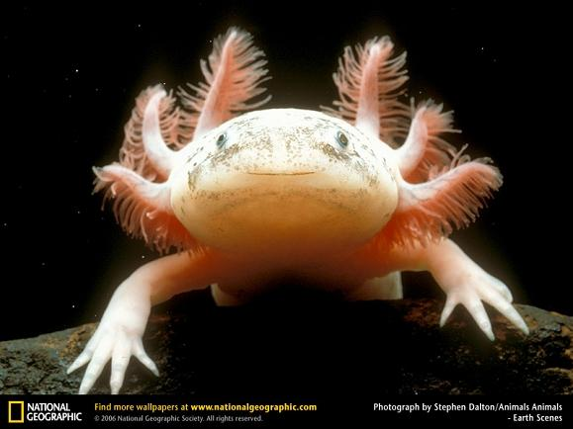
AMPHIBIANS

Slide 2
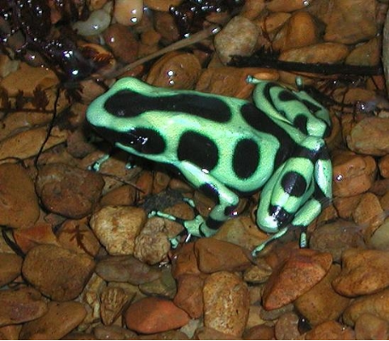
What is an amphibian?
Vertebrate
Leads a “double life”
Moist skin
Metamorphosis

Slide 3
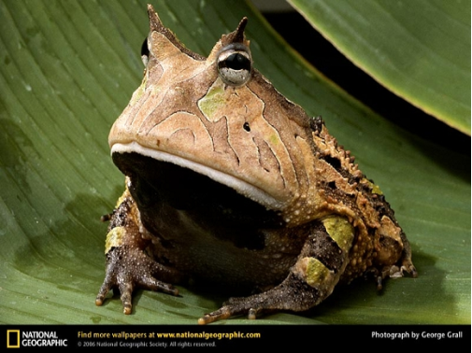
Development of Amphibians
Stronger Bones
Many have lungs to breathe air
Limbs to walk on land

Slide 4
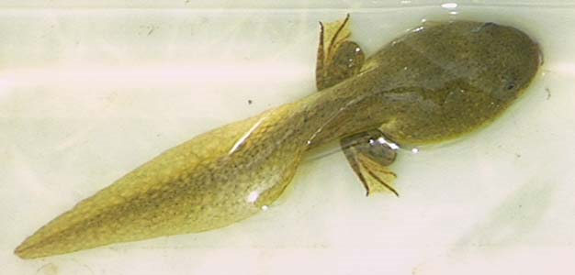
Feeding
Larva (tadpoles) are usually herbivores
Adults are usually carnivores

Slide 5
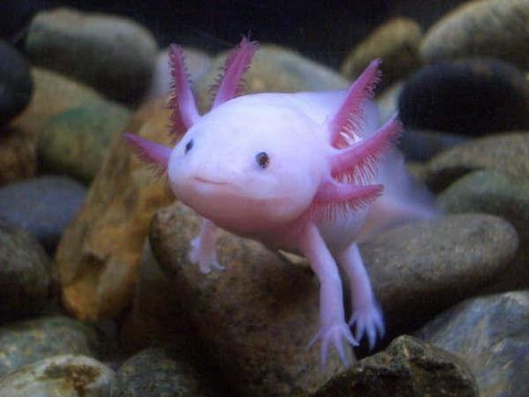
Respiration
Larva (tadpoles) breath with gills
Adult frogs have lungs
Some amphibians keep gills all their life, mudpuppy

Slide 6
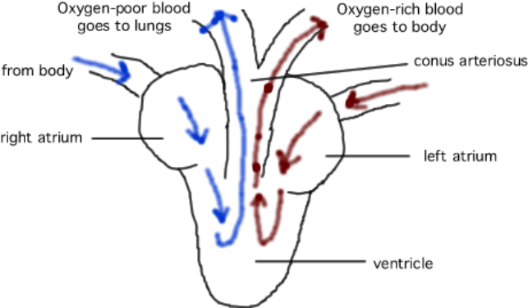
Circulation
Heart is a double loop, with 3 chambers and a ventricle that is partly divided

Slide 7
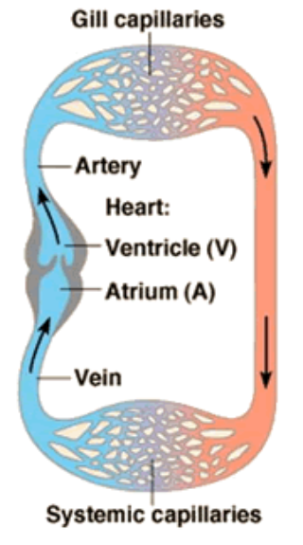
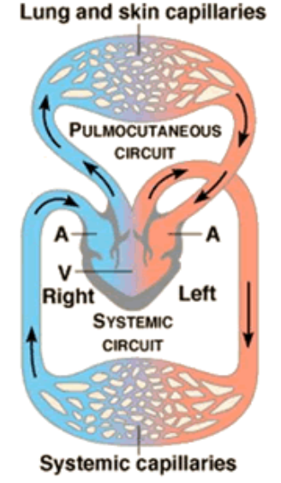

Slide 8
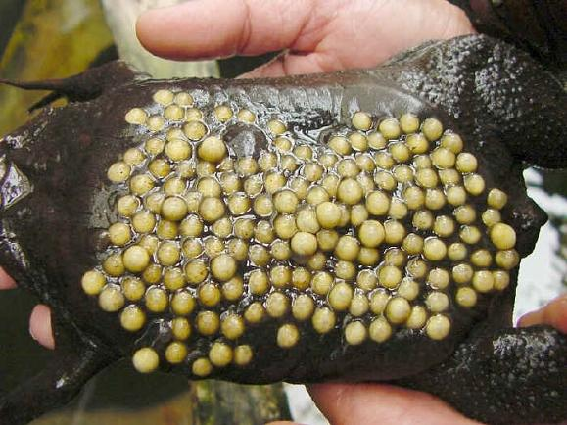
Reproduction
Frogs lay eggs, fertilization is external
Larva are aquatic

Slide 9
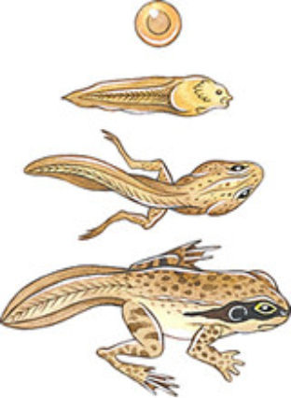
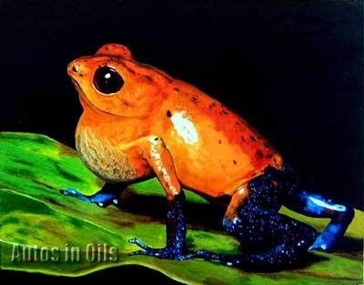
METAMORPHOSIS
Series of changes that occur as an organism grows

Slide 10
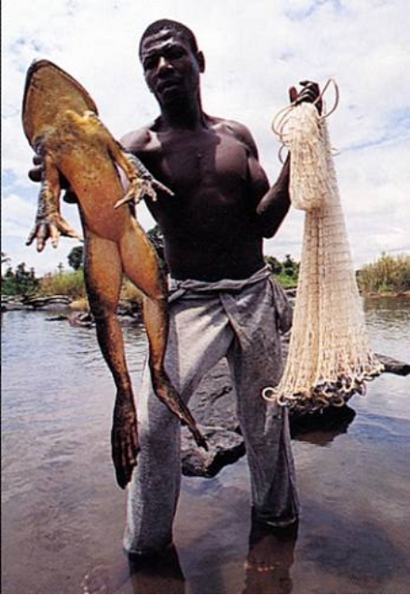
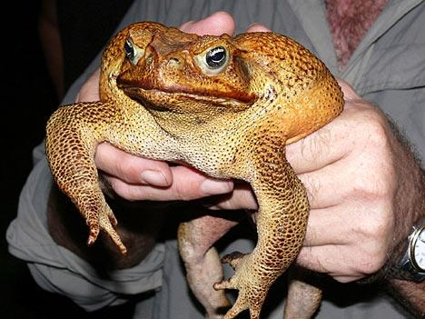
See videos at
http://video.nationalgeographic.com/video/player/animals/index.html

