Slide 1
Unit 4 “Genetics”
Section 11.4
MEIOSIS

Slide 2
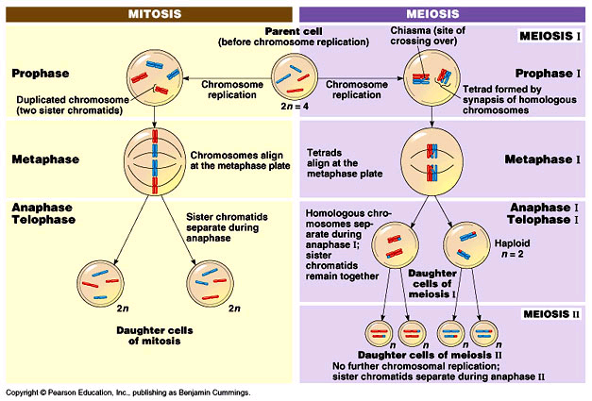

Slide 3
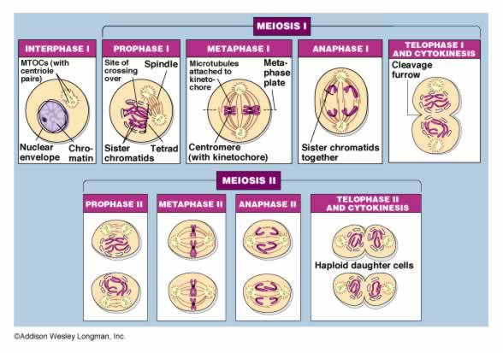

Slide 4
GENES and CHROMOSOMES
Gene-a segment of DNA that controls the production of a protein
Organisms have tens of thousands of genes
A thousand or more genes on each chromosome
Chromosomes occur in pairs-one from mom and one from dad.
Homologous---Identical

Slide 5
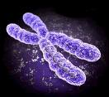

Slide 6
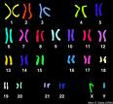

Slide 7
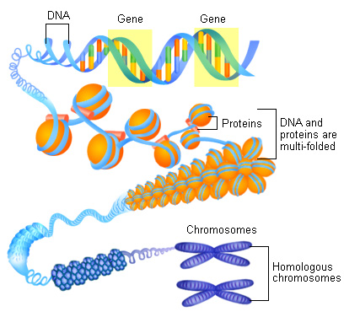

Slide 8
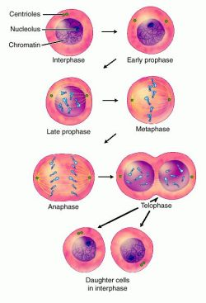
GENES, CHROMOSOMES, AND NUMBERS
A cell with two of each kind of chromosome:
Body cell
Diploid
2n

Slide 9
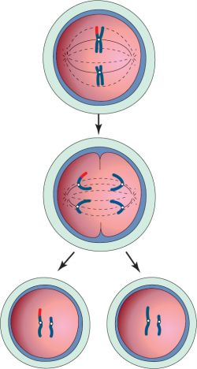
A cell with one of each kind of chromosome:
-- Gamete or sex cell
-- Haploid
-- n

Slide 10
CHROMOSOME NUMBERS
Chromosome numbers differ with each species
Organism | Body Cell (2n) | Gamete (n)
Fruit fly | 8
Garden pea | 14
Tomato | 24
Dog | 78
Human | 46

Slide 11
MEIOSIS
What is meiosis?
Cell division that produces gametes containing half the number of chromosomes (haploid)
Male gametes are called sperm
Female gametes are called eggs
When a sperm fertilizes an egg, the resulting cell is a zygote (sexual reproduction)

Slide 12
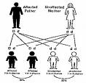
MEIOSIS
Why meiosis?
If we get half from mom and half from dad, there has to be a process within them that creates those “half” cells!
Chromosome numbers
cannot double
each generation

Slide 13
Phases of Meiosis
1. Interphase
Metabolic activity, replicate chromosomes
2. Prophase I
Tetrad forms (two homologous chromosomes)
Crossing over sometimes occurs

Slide 14
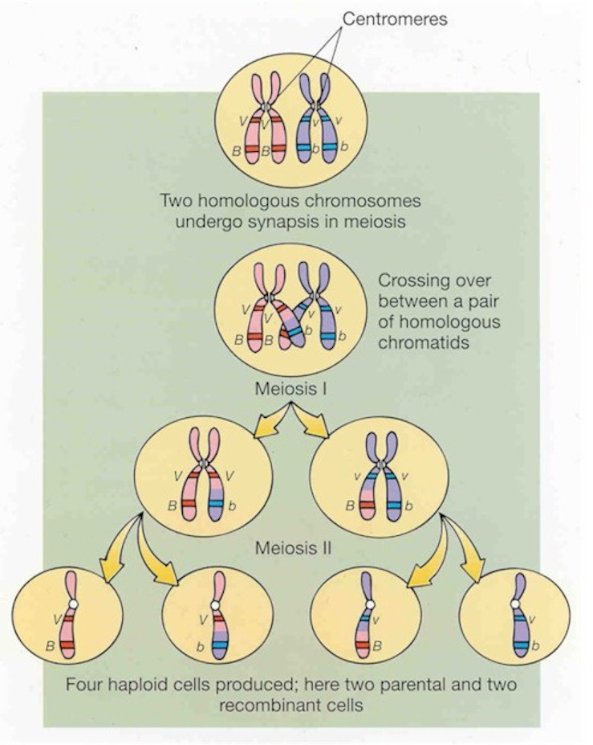
Phases of Meiosis
3. Metaphase I
Tetrads line in the middle.
4. Anaphase I
Homologous
chromosomes
separate and move
5. Telophase I
Two cells formed

Slide 15
Phases of Meiosis
Prophase II
--chromatids become visible.
Metaphase II
--chromatids line up in the middle.
Anaphase II
--paired chromatids separate and move to opposite ends.

Slide 16
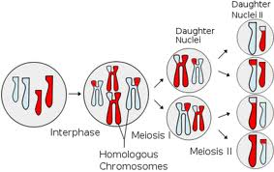
9. Telophase II
4 haploid cells have been formed, having half of the chromosome number (n) of the organism’s body cell

Slide 17
http://www.youtube.com/watch?v=eaf4j19_3Zg
http://www.youtube.com/watch?v=D1_-mQS_FZ0&list=PL441F493CA5C9F39E

