Slide 1
Organizing Life’s Diversity
Ch 7 Notes

Slide 2
Classification
Organization is important
Scientists classify organisms based on similarities.
Taxonomy-branch of biology that classifies
Early Systems:

Slide 3
Aristotle
Greek philosopher (384-322 B.C.)
Classified life into two groups:
Plants
Herbs, Shrubs, Trees
Animals
Land, Air, Water
Problems?

Slide 4
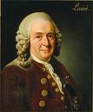
Carolus Linnaeus
Swedish botanist (1707-1778)
System developed to group organisms based on physical and structural similarities.
Still used today.

Slide 5
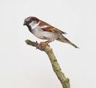
Taxonomy
System for classifying and identifying
Many purposes:
Medicinal
Economical
Used to study relationships
Two major aspects:
Classification
Nomenclature

Slide 6
Binomial Nomenclature
System to name organisms.
Latin…dead language (globally consistent)
Two names:
First is “genus”
Second is a “specific epithet”-describes organism
They combine to make the “species name”
Canis familiaris
Felis domesticus
Homo sapiens

Slide 7
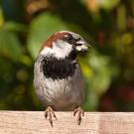
Scientific vs Common Names
Why not just use common names?
Is a “sea horse” a horse?
Is a “starfish” a fish?
Or a star?
Is a “bald eagle” really bald?
The case of the “house sparrow:”
Spain=gorrion
Holland=musch
Sweden=hussparf
ONLY ONE SCIENTIFIC NAME: Passer domesticus

Slide 8
Taxonomic Rankings or Classification Categories
Domain (3)
Kingdom (6)
Phylum
Class
Order
Family
Genus
Species (approx. 1.4 million named)

Slide 9
A Memory Hook
Keep
Pots
Clean
Or
Food
Gets
Stuck

Slide 10
Another Memory Hook
King
Philip
Came
Over
For
Great
Spaghetti

Slide 11
Yet Another Memory Hook
Kids
Prefer
Cheese
Over
Fried
Green
Spinach

Slide 12
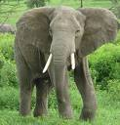
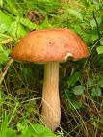
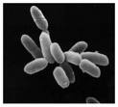
Six Kingdoms
Animals
Plants
Fungi
Protists
Archaebacteria
Eubacteria

