Slide 1
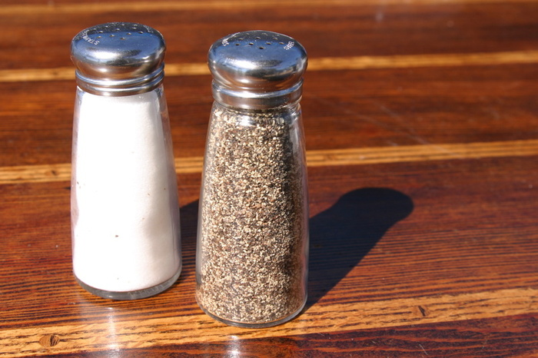
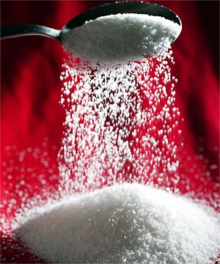
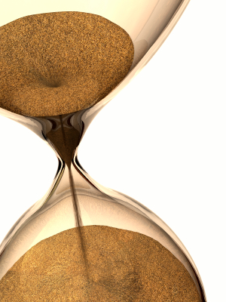
Section 2.2 Solutions and Suspensions
A. Mixture—composed of two or more elements or compounds that are physically(NOT chemically) mixed together. Examples: salt and pepper; sugar and sand.

Slide 2
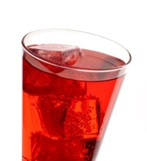
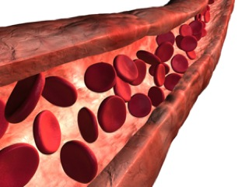
Solutions—all components are evenly distributed throughout the solution. Water is the solvent—the substance in which the solute dissolves.
Suspensions—a mixture of water and non dissolved material. Example: Blood is mostly water with dissolved compounds, but it also contains cells and other undissolved particles that remain in suspension.

Slide 3
Acids, Bases, and pH
H₂O H⁺ + OH⁻
--Water molecules sometimes split apart to form ions.
The pH Scale—measurement system used to indicate the concentration of H⁺ ions in a solution.
Scale ranges from 0 to 14. pH 7 is neutral, equal concentration of H⁺ ions and OH⁻ ions.
Acids—any compound that forms H⁺ ions in solution. Range is 0-6 with lower pH = strong acids.
Bases—any compound that forms OH⁻ ions in water. Range 8-14 with higher pH = stronger bases.

Slide 4
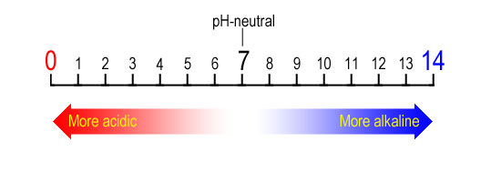
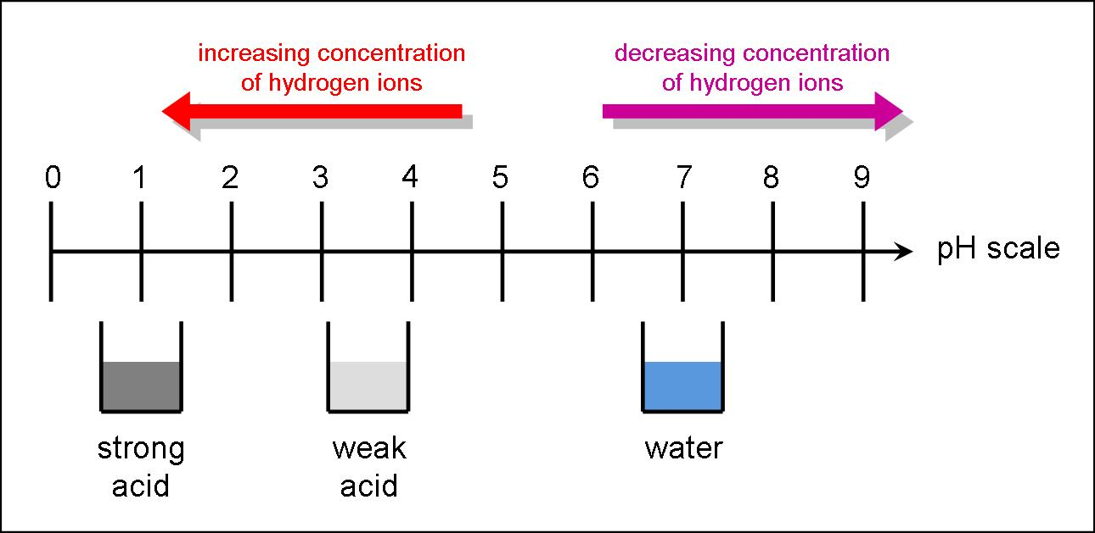

Slide 5
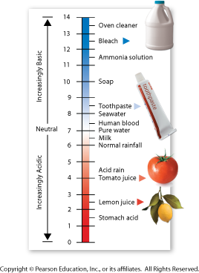

Slide 6
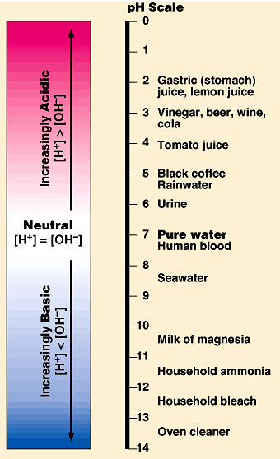
pH
[H+]= 10⁻¹M
pH = – log [H+]
Log scale means 10X change per unit!
[H+]= 10⁻⁹ M

