Slide 1
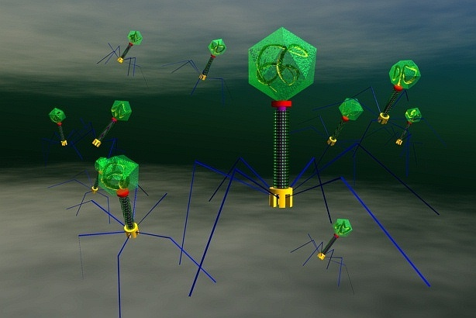
Chapter 20
Viruses

Slide 2
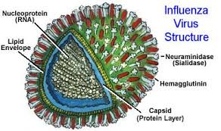

Slide 3
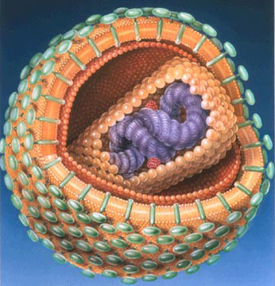
HIV Virus

Slide 4
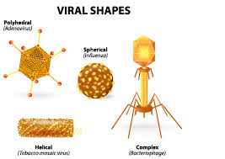

Slide 5
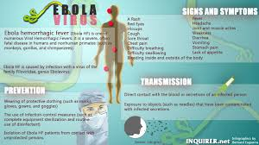
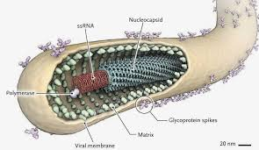

Slide 6
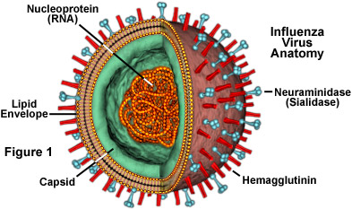
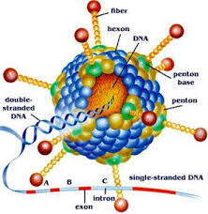

Slide 7
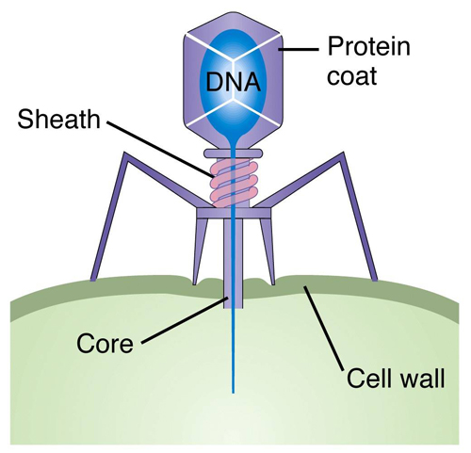

Slide 8
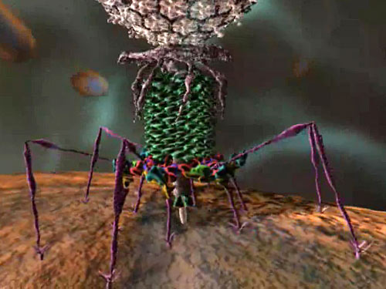

Slide 9
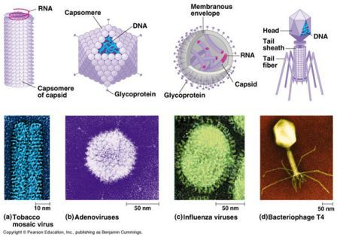
I. Viruses---tiny, non-living particles. They do not grow or carry out respiration. They ONLY reproduce inside a host cell.

Slide 10
II. Structure----a virus consists of an inner core of DNA or RNA (never both) surrounded by one or two proteins coats.

Slide 11
III. Viruses have a variety of shapes, determined by the protein coats. Viruses are species specific, with some being cell-type specific.

Slide 12
IV. Viral Reproductive Cycles A. Lytic Cycle –Virus destroys the host cell’s DNA, uses cell’s energy and materials to make new viruses.

Slide 15
B. Lysogenic Cycle --- the viral nucleic acid (DNA or RNA) becomes a part of the chromosome of the host cell, lays dormant, and replicates with it.

Slide 17
C. Provirus – virus is in the cell’s chromosome and not active. D. Retroviruses --- RNA viruses with the most complex reproductive cycles.

Slide 18
V. Origin of Viruses – unknown—maybe some DNA or RNA escaped from a host cell and developed a way to reproduce as parasites.

Slide 19
https://youtu.be/PHp6iYDi9ko

