Slide 1
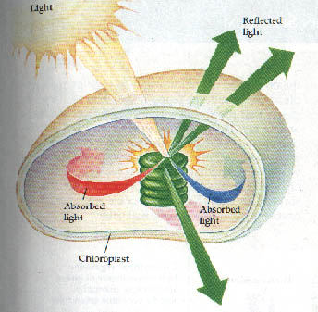
Chapter 8 Photosynthesis
6CO₂ + 6H₂O + Light Energy C₆H₁₂O₆ + 6O₂
---Takes place in the chloroplast of plant cells.
---Plants are green because they reflect the green light of the light spectrum and absorb all the other colors.

Slide 3
What Is ATP?
The energy molecule used by all cells is ATP.
Adenosine Triphosphate– Adenine Base, Ribose Sugar and 3 Phosphates
Organic molecule containing high-energy Phosphate bonds

Slide 4
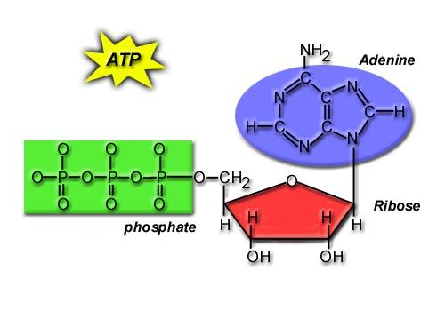
Chemical Structure of ATP
Base
3 Phosphates
Sugar

Slide 5
What Does ATP Do for You?
It supplies YOU with ENERGY!

Slide 6
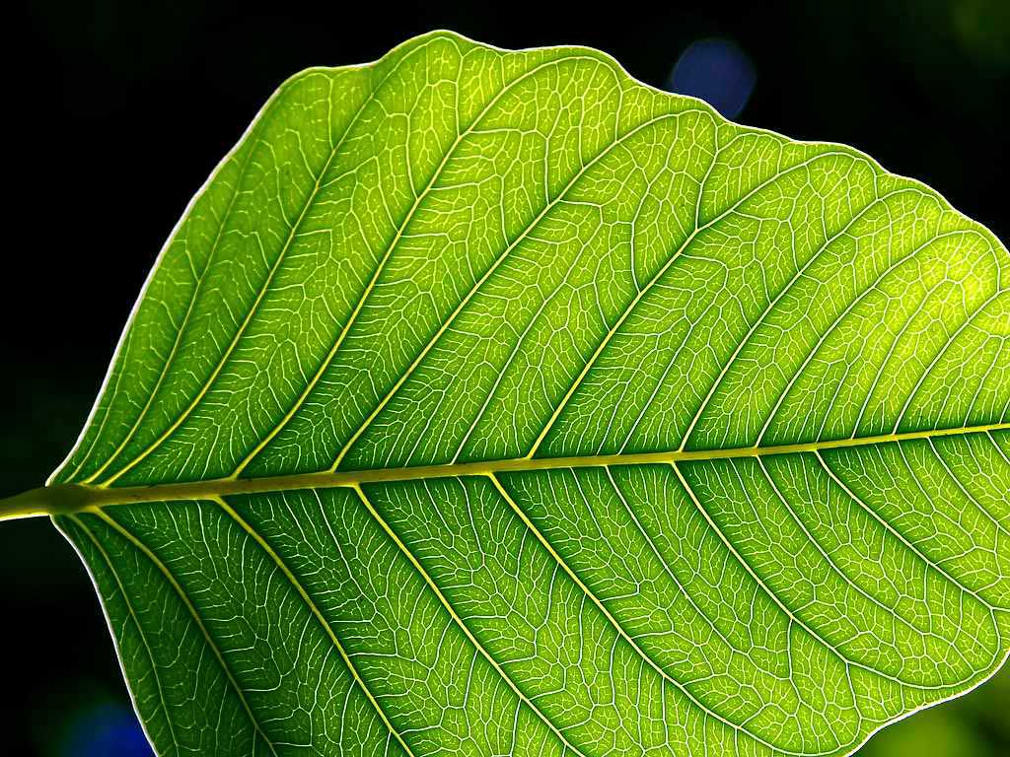
Phases of Photosynthesis
12 H₂O Water
ATP +
12 H₂ ions
Light Reactions
6 O₂ Oxygen

Slide 7
Carbon Dioxide
6CO₂
Produces:
C₆H₁₂O₆
Simple Sugar (Glucose)
Calvin Cycle
6H₂O Water

