Slide 1
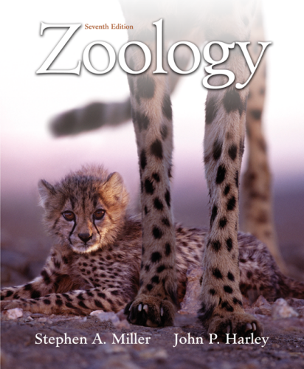
Chapter 1
Copyright © The McGraw-Hill Companies, Inc. Permission required for reproduction or display.

Slide 2
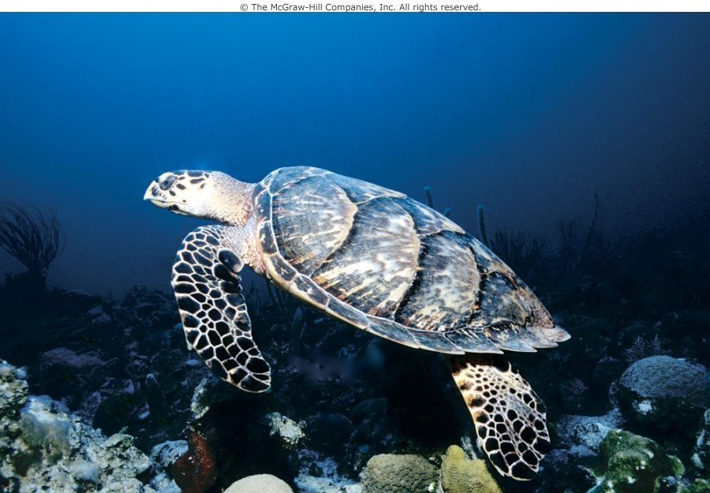
Part 1
II. Zoology---the study of animals.
----it’s a subset of the broad discipline of biology.
----the cell is the basic unit of life.
----Zoology looks at animals cells and then whole animals in more detail.

Slide 3
Chapter 1
II. Evolutionary Perspective---awareness of common evolutionary history allows us to look at structures and functions of animals living now.
Organic evolution—is change in the genetic makeup of populations of organisms over time.
Classification---particular features that are shared among groups of animals are used as the basis of animal classification.

Slide 4
C. Binomal nomenclature---used to give a genus and species name for every living organism. -----Names above the genus level(e.g., family, class, or phylum) group organisms together according to the degree of shared ancestry(shared features).

Slide 5
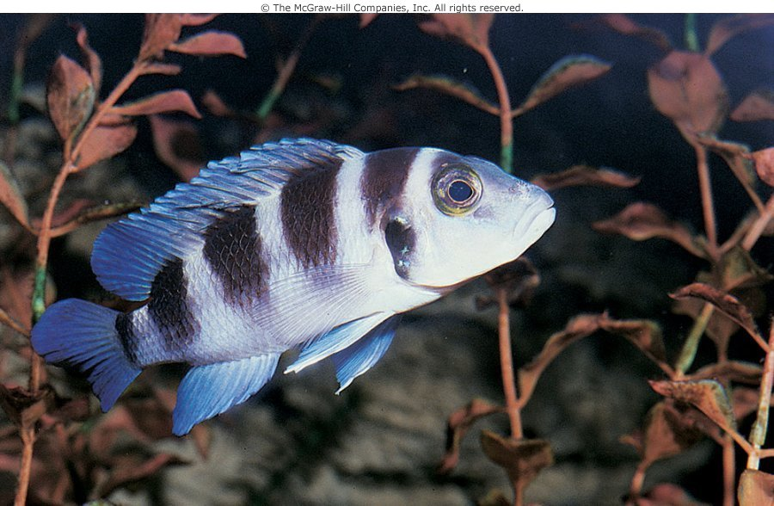
Figure 1.1 (a)

Slide 6
III. Zoology: An Ecological Perspective
Animals are intimately linked to their environment.
Ecology– the study of the interactions between animals and their environment.
The environment is a source of resources for all organisms. Resources such as shelter, food and water. With the rapid grow and spreading of human populations environments of other animals are impacted as these resources are degraded.

Slide 7
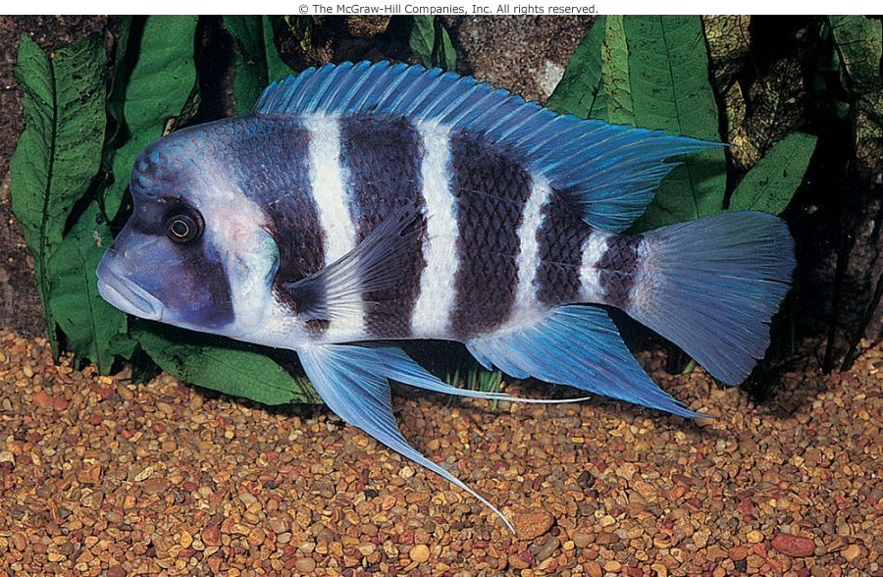
Figure 1.1 (b)

Slide 8
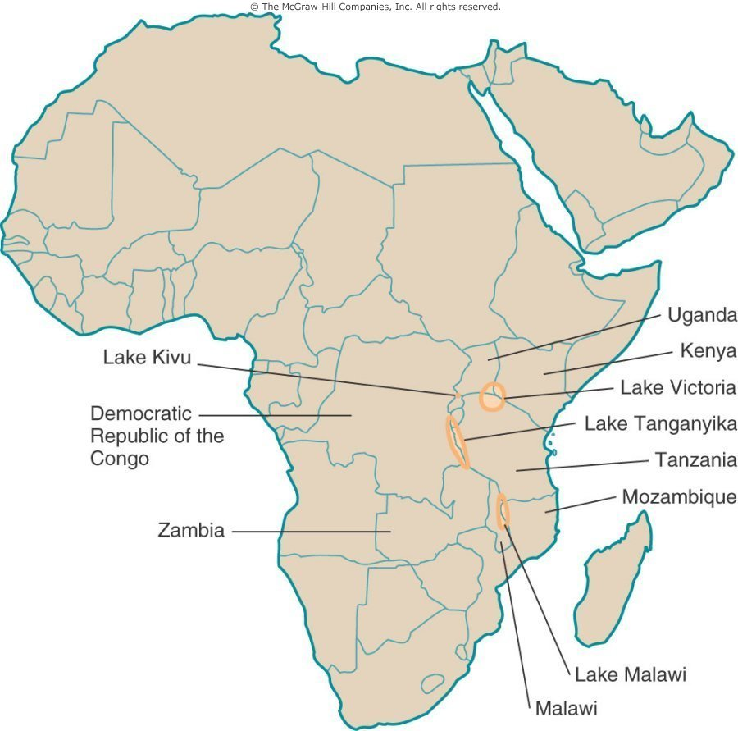
Figure 1.3

Slide 9
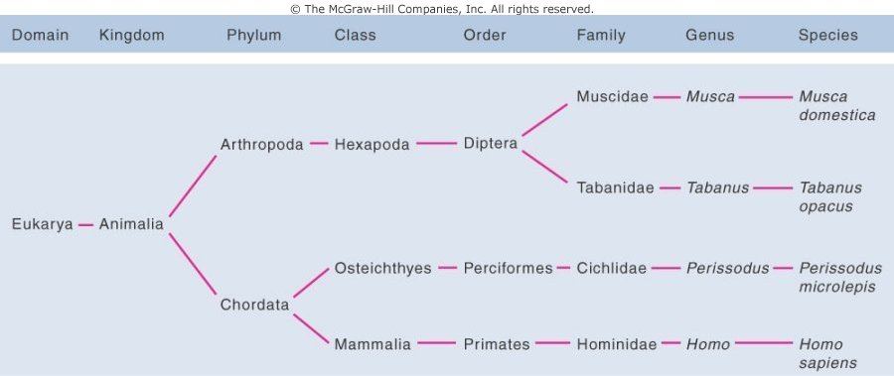
Figure 1.4

Slide 10
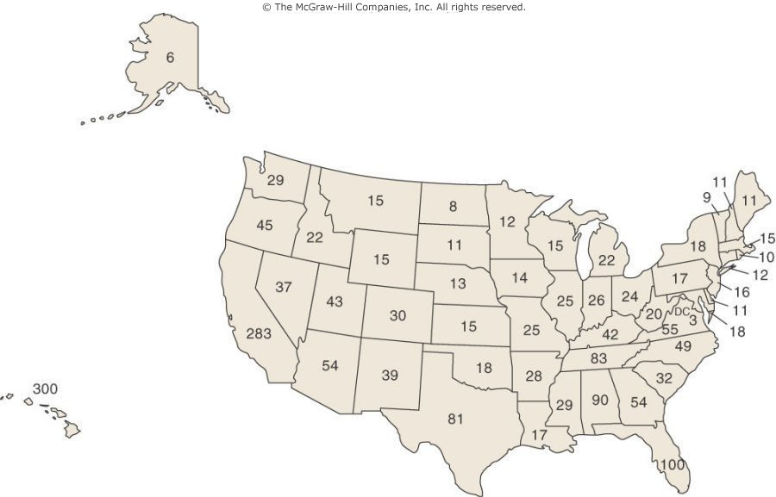
Box Figure 1.1

Slide 11
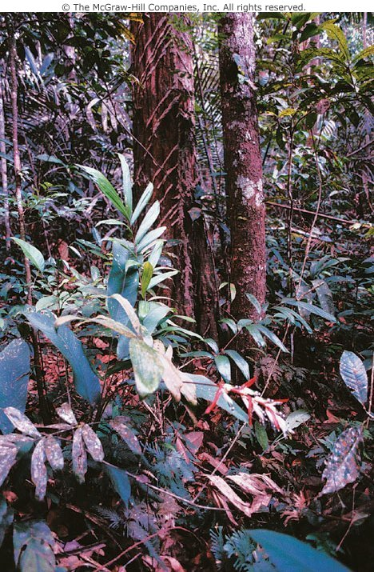
Figure 1.6 (a)

Slide 12
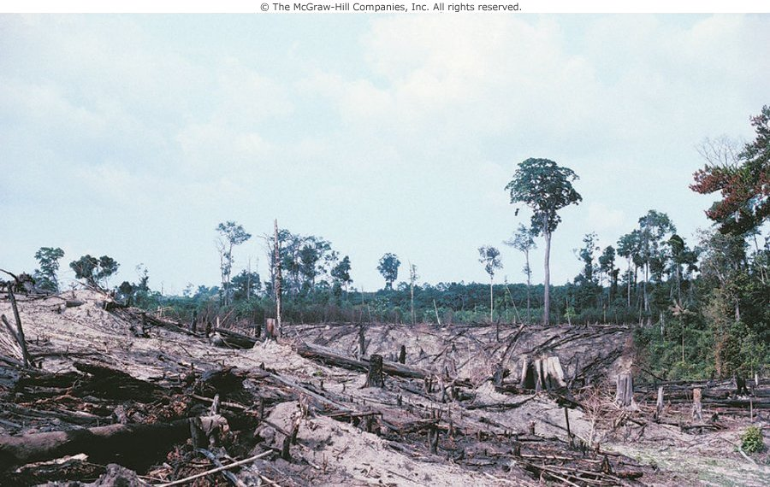
Figure 1.6 (b)

Slide 13
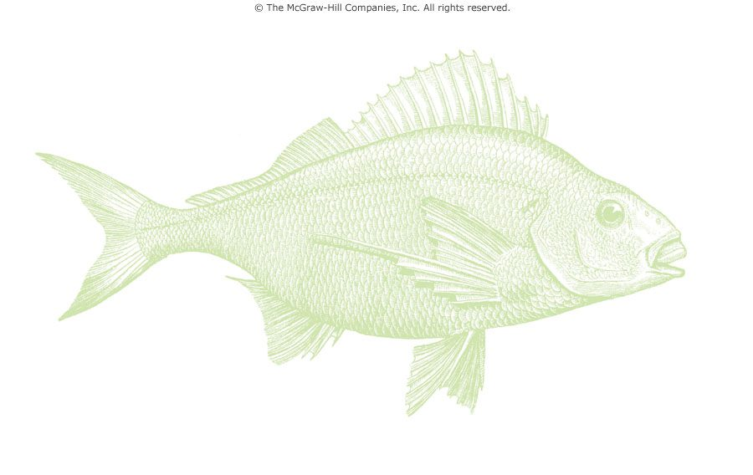
EOC Figure

