Slide 1
Chapter 4 Evolution

Slide 2
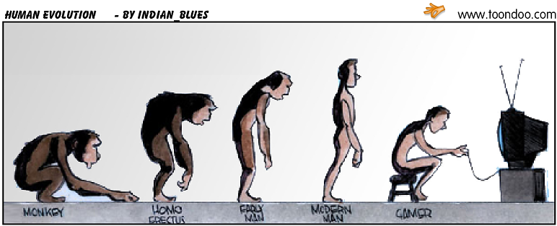

Slide 3
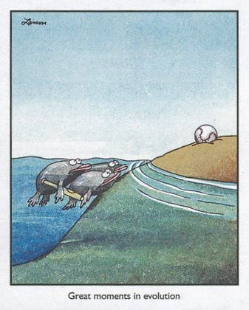

Slide 5
The Theory of Evolution
English scientist Charles Darwin is considered the founder of modern evolutionary theory.
Artifical Selection --- a technique in which a breeder selects particular traits.
Natural selection --- nature selects organisms with variations for a particular environment survive, reproduce, and pass on traits to the next generations.

Slide 6
ARTIFICIAL SELECTION
Human influences on genes of populations
Plants-corn, fruits, etc
Animals-dogs, cattle, horses, etc
Resistance-pesticide/antibiotic
Physiological Adaptations…can be rapid

Slide 7
NATURAL SELECTION
Organisms produce more than can survive
Environment is hostile, limited resources
Organisms differ in traits
Some inherited traits provide advantage
Each succeeding generation contains proportionately more organisms with advantageous traits

Slide 8
Defining Evolution
Evolution---gradual change over time; evolution is an unguided, unplanned process of random mutations and natural selection.
Microevolution– minor variations that occur in populations over time.

Slide 9
--- Macroevolution--- the emergence of major innovations or the unguided development of new structures (like wings), new organs (like lungs), and body plans (like the origin of insects and birds).
The molecules to frogs, to apes, to man evolution.

Slide 10
Adaptations
Any variation that aids an organism’s chances of survival in its environment
Examples

Slide 11
Camouflage

Slide 12
Warning Coloration

Slide 13
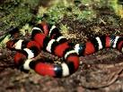
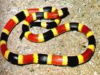
Mimicry

Slide 14
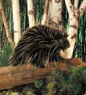
Protective Covering

Slide 15
Other Evidence
Fossils
Anatomy
Homologous structures
Analogous structures
Vestigial structures
Embryology
Biochemistry

Slide 16
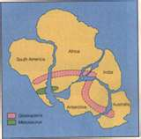
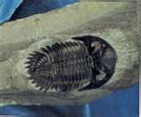
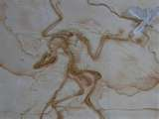
Fossils

Slide 17
Homologous Structures

Slide 18
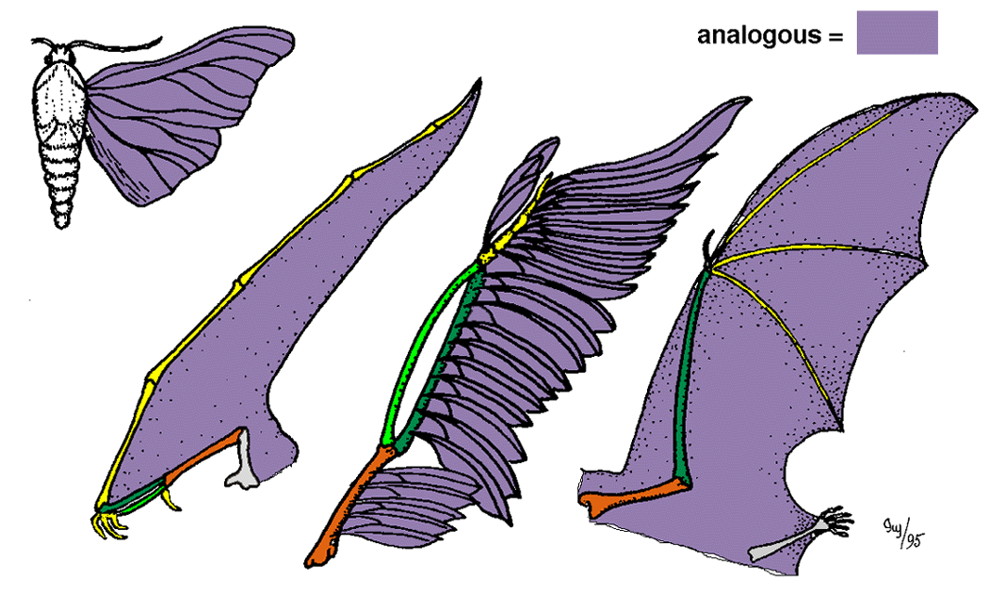
Analogous Structures

Slide 19
Vestigial Structures

Slide 20
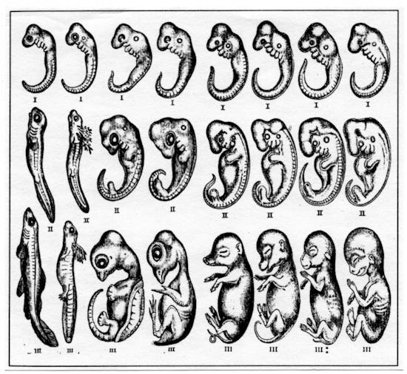
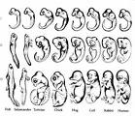
Embryology

Slide 21
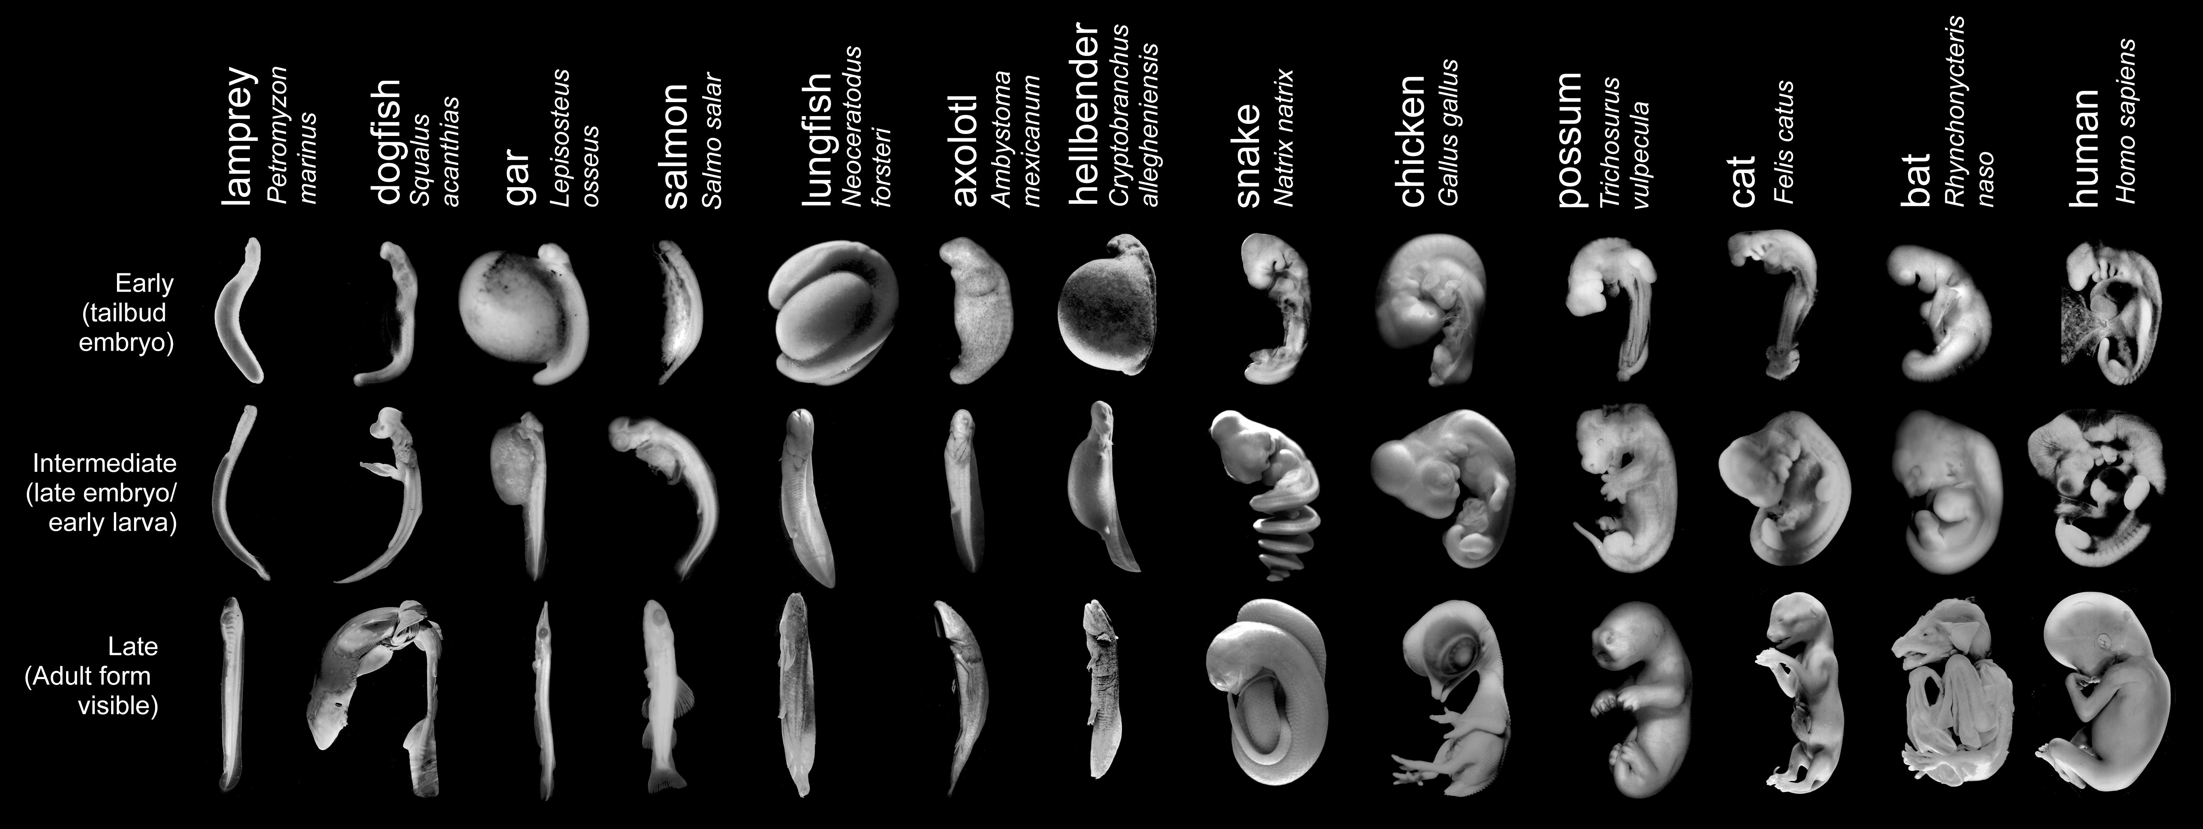
Better Photo of Embryology

Slide 22
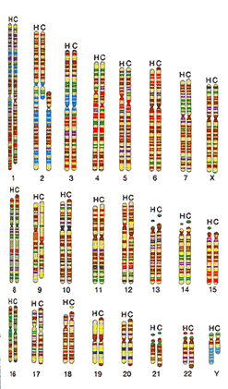
Biochemistry

Slide 23
Mechanisms of Evolution
Population Genetics
Allele frequency
Genetic equilibrium
Changes in Genetic Equilibrium
Any factor that affects allelic frequency

Slide 24
Types of Selection
Stabilizing-favors average
Directional-favors one extreme
Disruptive-favors both extremes

Slide 25
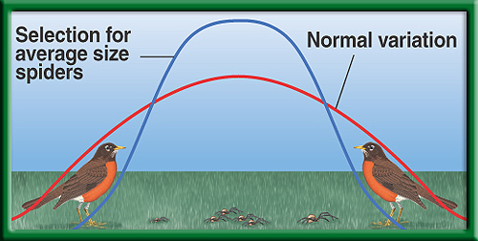

Slide 26
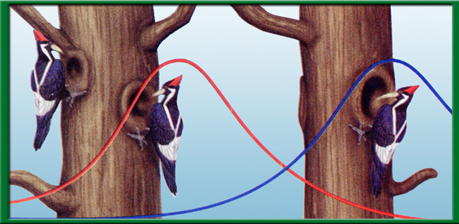

Slide 27
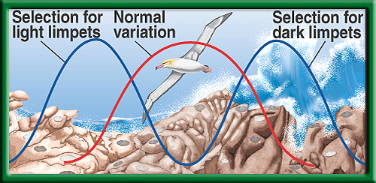

Slide 28
Evolution Of Species
Speciation-evolution of new species
Geographic Isolation
Reproductive Isolation
Gradualism-species originate through gradual series of adaptations

Slide 29
