Slide 1
Classification
Ch 18 Notes

Slide 2
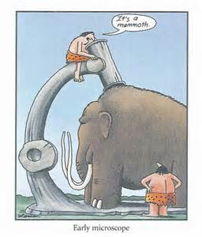
Classification
Organization is important
Scientists classify organisms based on similarities
Taxonomy-branch of biology that classifies
Early Systems:

Slide 3
Aristotle
Greek philosopher (384-322 B.C.)
Classified life into two groups:
Plants
Herbs, Shrubs, Trees
Animals
Land, Air, Water

Slide 4
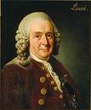
Carolus Linnaeus
Swedish botanist (1707-1778)
System developed to group organisms based on physical & structural similarities.
Still used today.

Slide 5
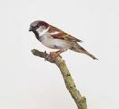
Taxonomy
System for classifying and identifying
Many purposes:
Medical
Economical
Used to study relationships
Two major aspects:
Classification
Nomenclature

Slide 6
Binomial Nomenclature
System to name organisms.
Latin…dead language (globally consistent)
Two names:
First is “genus”
Second is a “species name”-describes organism
They combine to make the “species name”
Canis familiaris
Felis domesticus
Homo sapien

Slide 7
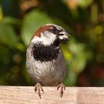
Scientific vs Common Names
Why not just use common names?
Is a “sea horse” a horse?
Is a “starfish” a fish?
Or a star?
Is a “bald eagle” really bald?
The case of the “house sparrow:”
Spain=gorrion
Holland=musch
Sweden=hussparf
ONLY ONE SCIENTIFIC NAME: Passer domesticus

Slide 8
Taxonomic Rankings or Classification Categories
Kingdom (6)
Phylum
Class
Order
Family
Genus
Species (approx. 1.4 million named)

Slide 10
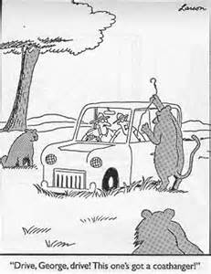
A Memory Hook
Keep
Pots
Clean
Or
Food
Gets
Stuck

Slide 11
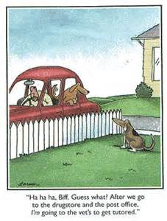
Another Memory Hook
King
Philip
Came
Over
For
Great
Spaghetti

Slide 12
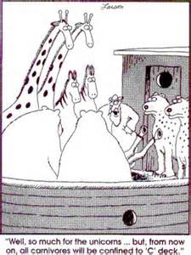
Yet Another Memory Hook
Kids
Prefer
Cheese
Over
Fried
Green
Spinach

Slide 13
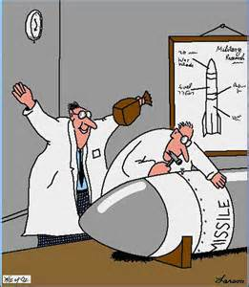
And Yet Another Memory Hook
Kings
Play
Chess
On
Fine
Green
Sand

Slide 14
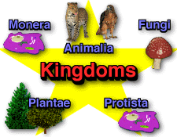

Slide 15
18.2 Notes
Six Kingdoms

Slide 16
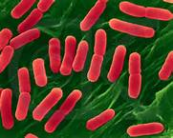
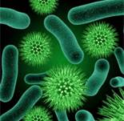
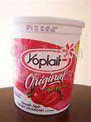
Eubacteria

Slide 17
Eubacteria
Eubacteria
Prokaryotes/unicellular
Some heterotrophs, some autotrophs
About 5000 species of bacteria
Live in most habitats
Most are harmful; many are helpful
Some have the ability to move

Slide 18
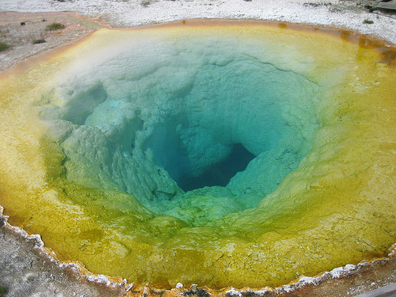
Archaebacteria
Prokaryotes/unicellular
Some heterotrophs, some autotrophs
About 200 species
Live in extreme environments:
Swamps, deep ocean, hydrothermal vents….no oxygen
Structurally different from Eubacteria

Slide 19
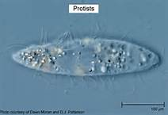
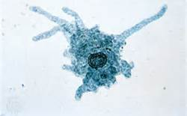
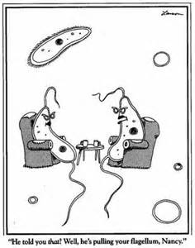
Protists

Slide 20
Protists
Eukaryotes/some unicellular, some multicellular
Some plant-like, some animal-like, some fungus-like
Very diverse species
Some move

Slide 21
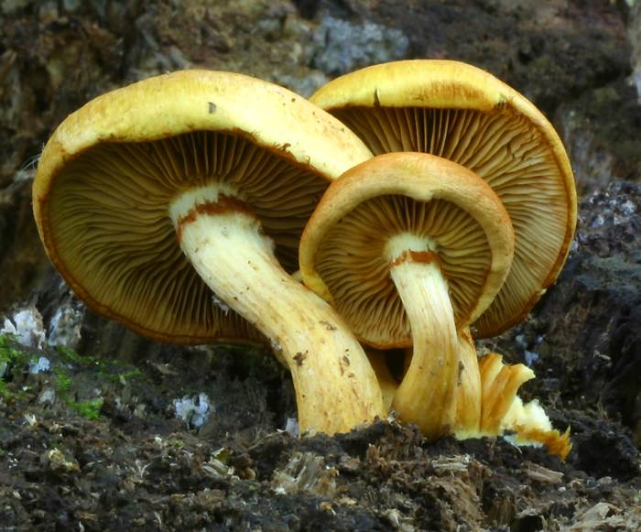
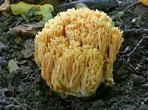
Fungi

Slide 22
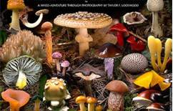

Slide 23
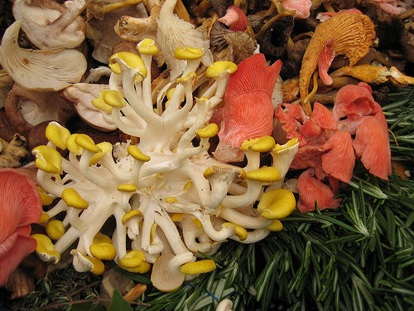
Fungi
Unicellular/multicelluar, Eukaryotic heterotrophs
More than 50000 species
Absorb nutrients from organic materials in the environment (decomposers)
Do not move

Slide 24
Unicellular/multicelluar, Eukaryotic heterotrophs
More than 50000 species
Absorb nutrients from organic materials in the environment (decomposers)
Do not move

Slide 25
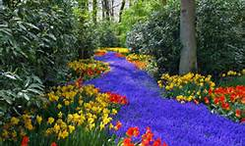
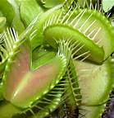
Plants

Slide 26
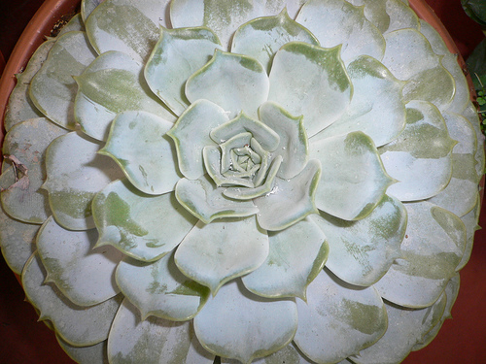
Plants
Multicellular, eukaryotic, photosynthetic autotrophs
Very diverse species with organs and organ systems
Contain chloroplasts and have cell walls composed of cellulose
Do not move

Slide 27
Multicellular, eukaryotic, photosynthetic autotrophs
Very diverse species with organs and organ systems
Contain chloroplasts and have cell walls composed of cellulose
Do not move

Slide 28
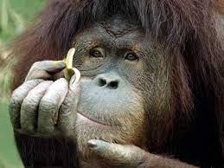
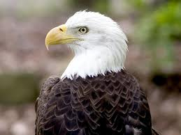
Animals

Slide 29
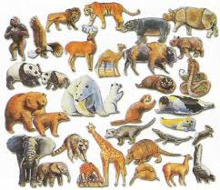

Slide 30
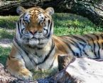
Animals
Multicellular/ heterotrophs
Cells organized into tissues, organs, organ systems
Nearly all able to move

Slide 31
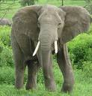
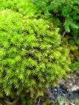
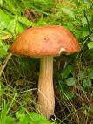
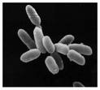
Six Kingdoms
Animals
Plants
Fungi
Protists
Archaebacteria
Eubacteria

