Slide 1
Chapter 7.3
Cells and Their Environment

Slide 3
I. Cell Membrane
Cell Membrane
All cells surrounded by a double membrane called a bilayer.
Protects the cell and helps move substances and messages in and out of the cell.
By regulating transport, the membrane helps the cell maintain homeostasis.

Slide 4
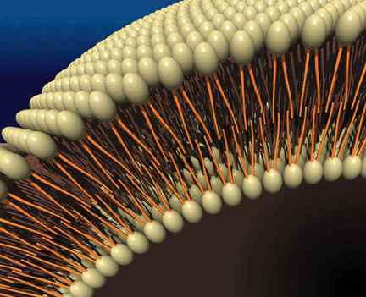

Slide 7
Homeostasis
The maintenance of stable internal conditions in a changing environment.
One way that a cell maintains homeostasis is by controlling the movement of substances across the cell membrane.

Slide 8
II. Cell Membrance Structure
Lipid Bilayer
Phospholipid- a specialized lipid made of a phosphate “head” and two “fatty acid” tails.
The phosphate head is hydrophilic (water-loving).
The fatty acid tails are hydrophobic (water-fearing).

Slide 9
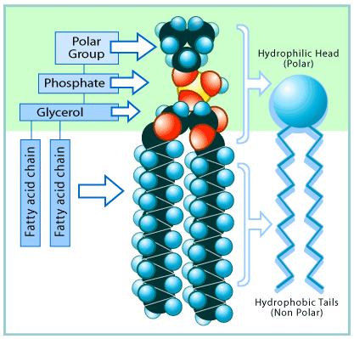

Slide 11
Barrier
The phospholipids form a barrier through which only small, fat-soluble (non-polar), substances can pass.
Often called “selectively permeable”.

Slide 12
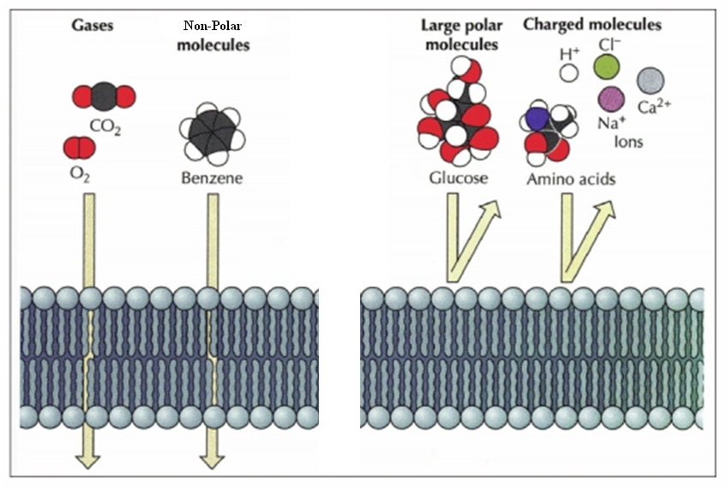

Slide 13
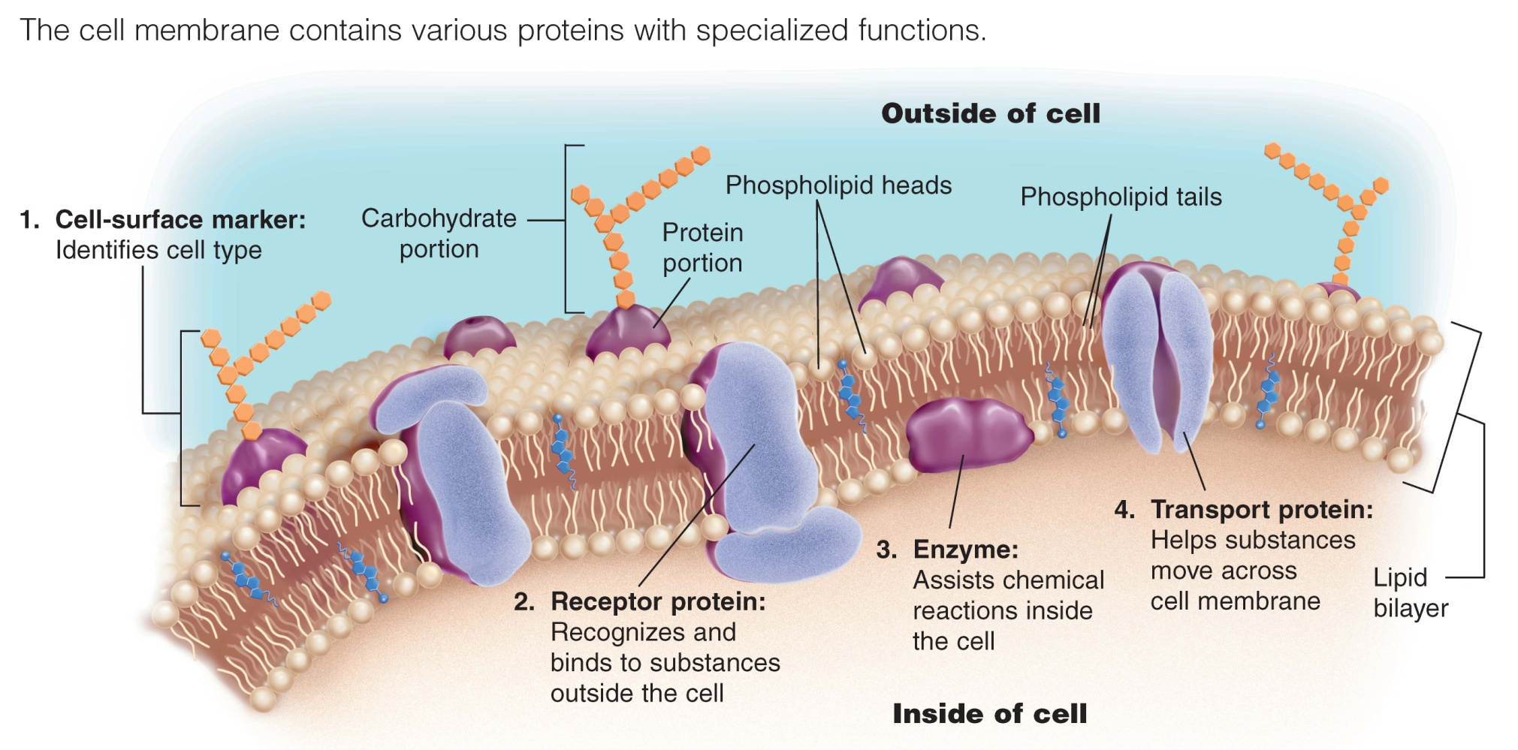

Slide 14
III. Cell Transport
Passive Transport- transport of substances across cell membrane DOES NOT require ATP energy.
Active Transport- transport of substances across cell membrane requires ATP energy.

Slide 15
Types of Passive Transport
1. Simple Diffusion
The movement of molecules from an area of high concentration to low concentration.
Small, fat-soluble molecules can pass directly through the lipid bilayer.

Slide 16
2. Facilitated diffusion
Transport proteins help substances that do not easily diffuse across the membrane get across.
Channel proteins (pores)
Carrier proteins

Slide 17
Channel Proteins

Slide 18
Carrier Proteins

Slide 19
http://youtu.be/svAAiKsJa-Y

Slide 20
3. Osmosis
The diffusion of water across a selectively permeable membrane.

Slide 23
IV. Predicting water movement
1. Hypertonic solutions
water moves out of the cell.
The cell loses water and shrinks.

Slide 24
2. Hypotonic solutions
water moves into the cell.
The cell gains water and expands in size.

Slide 25
3. Isotonic solutions
water diffuses into and out of the cell at equal rates.
The cell stays the same size.
Effects of osmosis
If left unchecked, the swelling caused by a hypotonic solution could cause a cell to burst.
Cell walls in plants prevent the membrane from expanding too much.

Slide 27
Cell Transport
http://highered.mcgraw-hill.com/olcweb/cgi/pluginpop.cgi?it=swf::535::535::/sites/dl/free/0072437316/120068/bio02.swf::Endocytosis%20and%20Exocytosis

Slide 28
V. Bulk Transport
Endocytosis
The movement of large substances into a cell by means of a vesicle.
Exocytosis
The movement of material out of a cell by means of a vesicle.

