Slide 1
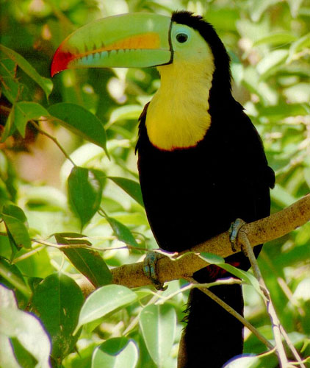
Ecology

Slide 2
WHAT IS ECOLOGY?
Ecology- the scientific study of interactions between organisms and their environments, focusing on energy transfer
Ecology is a science of relationships
Notes:
What do you think about when I say ecology? Recycling? Acid rain?

Slide 3
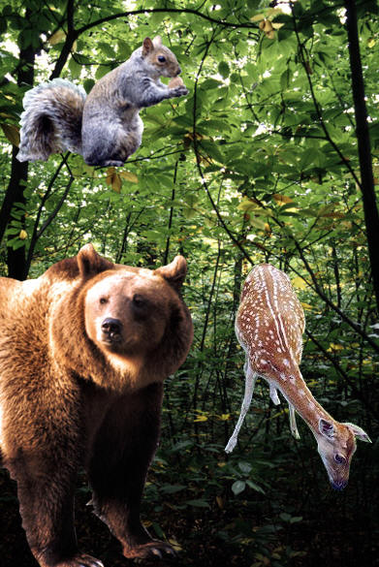
WHAT DO YOU MEAN BY ENVIRONMENT?
The environment is made up of two factors:
Biotic factors- all living organisms inhabiting the Earth
Abiotic factors- nonliving parts of the environment (i.e. temperature, soil, light, moisture, air currents)
Notes:
When I say environment you think what—weather. Well Ok but it it much more than that

Slide 4
Biosphere
Ecosystem
Community
Population
Organism
Notes:
Just like with classification, ecology is hierarchal. Each level builds on itself and they fit together like nesting boxes.

Slide 5
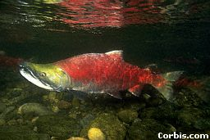
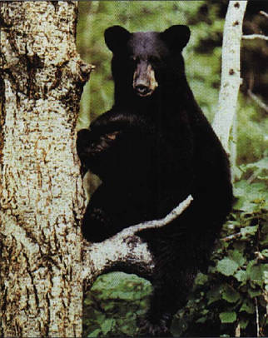
Organism - any unicellular or multicellular form exhibiting all of the characteristics of life, an individual.
The lowest level of organization
Notes:
The lowest level is the individual. The organism. Here we see a salmon and a bear as examples of organisms. REMINDER: organisms die, species go extinct

Slide 6
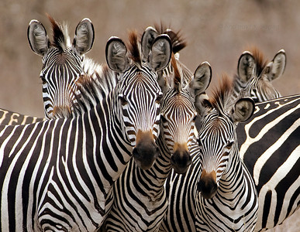
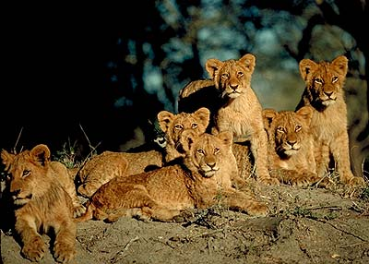
POPULATION
a group of organisms of one species living in the same place at the same time that interbreed
Compete with each other for resources (food, mates, shelter, etc.)
Produce fertile offspring
Notes:
The next level is a population. A population consists of a single species living together and breeding. Give me an example of a population. Ex. large mouth bass living in Lake Meade. Beetles living under the same log. Here we have salmon spwning and two bears fishing.

Slide 7
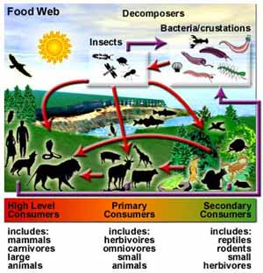
Community - several interacting populations that inhabit a common environment and are interdependent.
Notes:
Next level is a community which is several populations living together and depending on each other. What does interdependent mean? An example of a community is shown here with the bear and the salmon. They both live in a common environment and the bear needs the fish for food? How does the salmon need the bear?

Slide 8
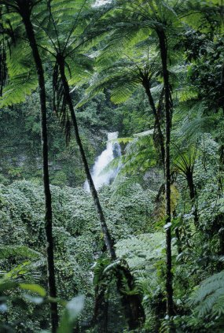
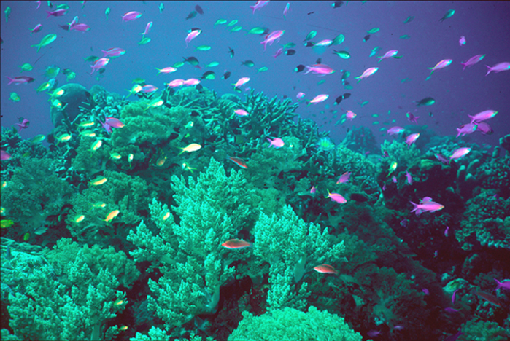
Ecosystem - populations in a community and the abiotic factors with which they interact (ex. marine, terrestrial)

Slide 9
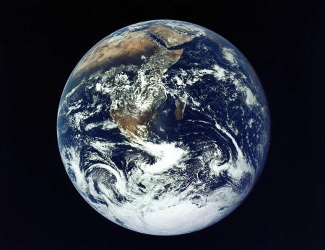
Biosphere - life supporting portions of Earth composed of air, land, fresh water, and salt water.
The highest level of organization
Notes:
Lets review. Organisms make up populations, populations make up communities, communities and abiotic factors make up ecosystems, and all of the ecosystems make up the biosphere. From one to many and each depending on the other.

Slide 10
Habitat vs. Niche
Niche - the role a species plays in a community; its total way of life
Habitat- the place in which an organism lives out its life
Notes:
Although several species may share a habitat they each have their own niche. A niche is a very narrow range where a species fits within a habitat.

Slide 11
Habitat vs. Niche
A niche is determined by the tolerance limitations of an organism, or a limiting factor.
Limiting factor- any biotic or abiotic factor that restricts the existence of organisms in a specific environment.
Notes:
Although several species may share a habitat they each have their own niche. A niche is a very narrow range where a species fits within a habitat.

Slide 12
Habitat vs. Niche
Examples of limiting factors -
Amount of water
Amount of food
Temperature
Amount of space
Availability of mates
Notes:
Although several species may share a habitat they each have their own niche. A niche is a very narrow range where a species fits within a habitat.

Slide 13
Feeding Relationships
There are 3 main types of feeding relationships
1. Producer - Consumer
2. Predator - Prey
3. Parasite - Host
Notes:
How do they trap the sun’s energy? Through what process? What is that process similar to in animal cells?

Slide 14
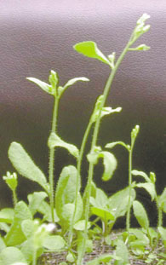
Feeding Relationships
Producer- all autotrophs (plants), they trap energy from the sun
Bottom of the food chain
Notes:
How do they trap the sun’s energy? Through what process? What is that process similar to in animal cells?

Slide 15
Feeding Relationships
Consumer- all heterotrophs: they ingest food containing the sun’s energy
Herbivores
Carnivores
Omnivores
Decomposers
Notes:
Energy moves up the food chain through the producer/consumer relationship.

Slide 16
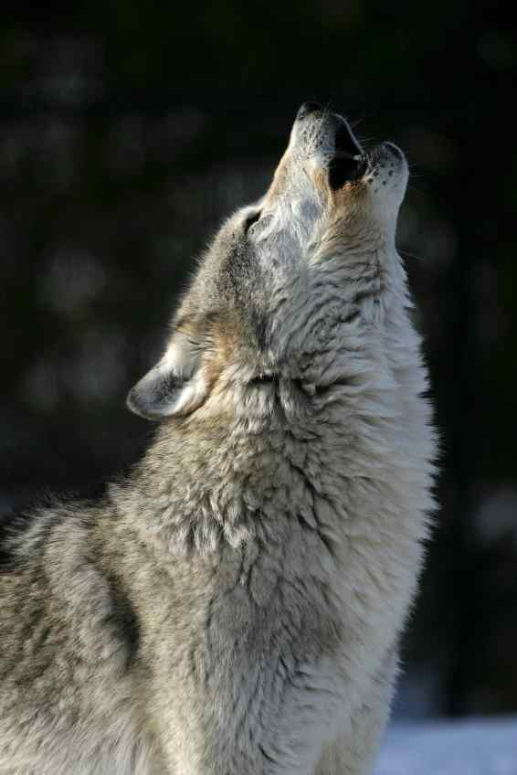
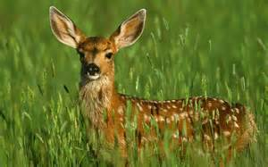
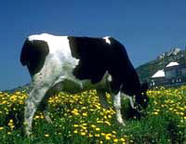
Feeding Relationships
Herbivores
Eat plants
primary consumers
hoofed animals
Notes:
Herbivores are the 1st step up the food chain, they eat the producers

Slide 17
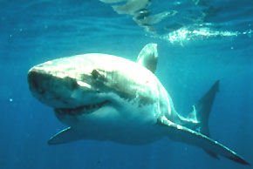
Feeding Relationships
Carnivores-eat meat
Predators
Hunt prey
animals for food.
Notes:
Scavengers are a type of carnivore that eat dead animals, or carrion. Vultures, hyenas, crabs, deep sea fish-talk about distance from the sun and must eat the dead things that sink to the bottom, bottom feeders

Slide 18
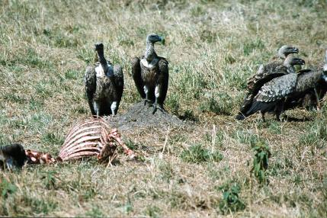
Feeding Relationships
Scavengers
Feed on carrion,
dead animals
Notes:
Scavengers are a type of carnivore that eat dead animals, or carrion. Vultures, hyenas, crabs, deep sea fish-talk about distance from the sun and must eat the dead things that sink to the bottom, bottom feeders

Slide 19
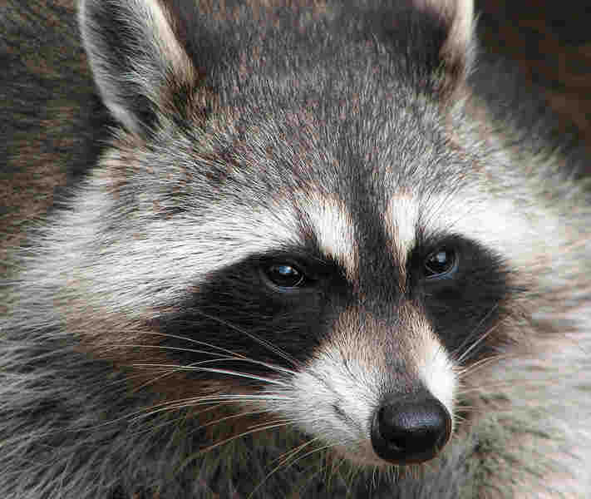
Feeding Relationships
Omnivores -eat both plants
and animals
Notes:
Humans and bears are omnivores but a large and important subset of omnivores are the decomposers. They breakdown dead producers and release the energy back into circulation.

Slide 20
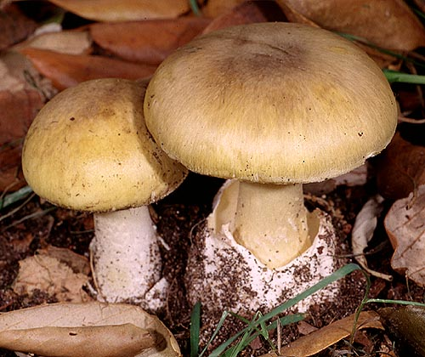
Feeding Relationships
Consumer- Decomposers
Breakdown the complex compounds of dead and decaying plants and animals into simpler molecules that can be absorbed
Notes:
Humans and bears are omnivores but a large and important subset of omnivores are the decomposers. They breakdown dead producers and release the energy back into circulation.

Slide 21
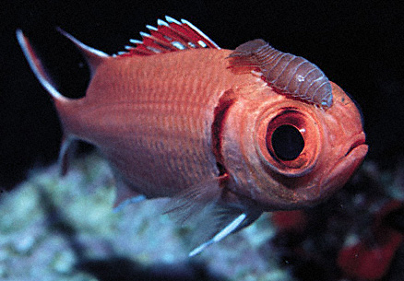
Symbiotic Relationships
Symbiosis- two species living together
3 Types of symbiosis:
1. Commensalism
2. Parasitism
3. Mutualism
Notes:
Cleaning shrimp

Slide 22
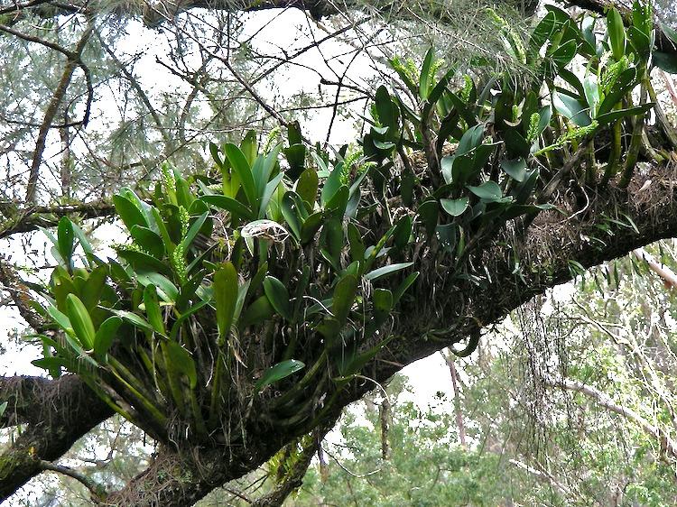
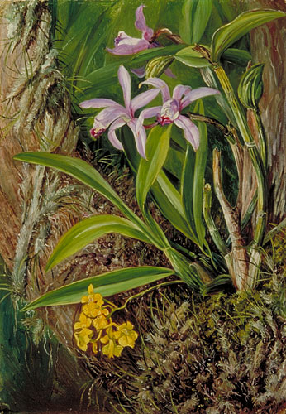
Symbiotic Relationships
Commensalism-
one species benefits and the other is neither harmed nor helped
Ex. orchids on a tree, Polar bears and cynabacteria
Epiphytes: A plant, such as a tropical orchid or a bromeliad, that grows on another plant upon which it depends for mechanical support but not for nutrients. Also called aerophyte, air plant.

Slide 23
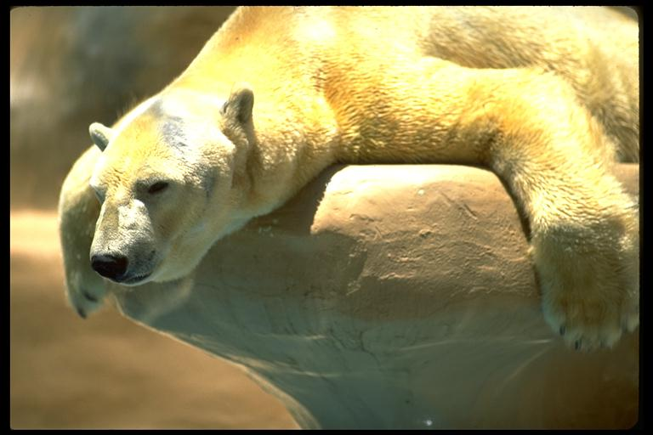
Symbiotic Relationships
Commensalism Example
Ex. polar bears and cyanobacteria
Notes:
You can see here that this polar bear is no longer white.

Slide 24
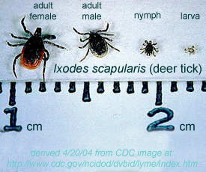
Symbiotic Relationships
Parasitism-
one species benefits (parasite) and the other is harmed (host)
Parasite-Host relationship

Slide 25
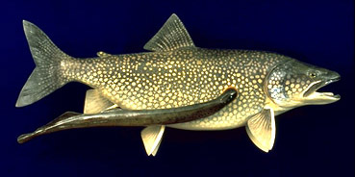
Symbiotic Relationships
Parasitism- parasite-host
Ex. lampreys,
leeches, fleas,
ticks, tapeworm

Slide 26
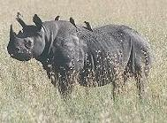
Symbiotic Relationships
Mutualism-
beneficial to both species
Ex. cleaning birds and cleaner shrimp, lichen
Notes:
The Egyptian plover takes insects from the backs of buffaloes, giraffes and rhinos. The plover has also been observed taking leeches from the open mouths of crocodiles! In this association the plover receives a supply of food and the other animal rids itself of unwelcome pests

Slide 27
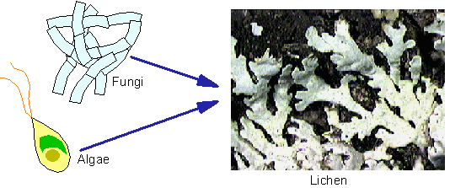
Symbiotic Relationships
(Mutualism)
Ex. lichen
Notes:
The Egyptian plover takes insects from the backs of buffaloes, giraffes and rhinos. The plover has also been observed taking leeches from the open mouths of crocodiles! In this association the plover receives a supply of food and the other animal rids itself of unwelcome pests

Slide 28
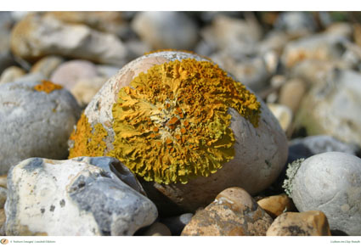
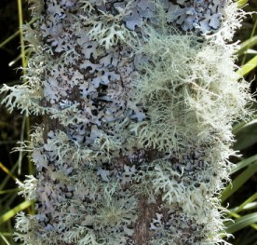
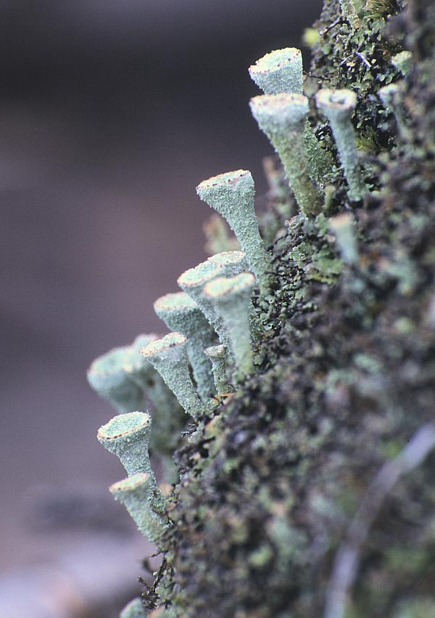
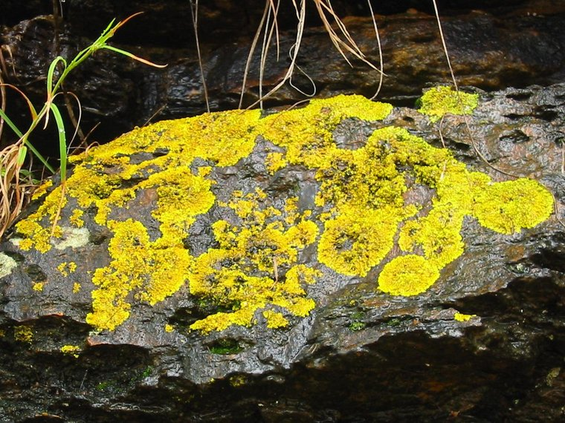

Slide 29
Type of relationship | Species harmed | Species benefits | Species neutral
Commensalism
Parasitism
Mutualism
= 1 species

