Slide 1
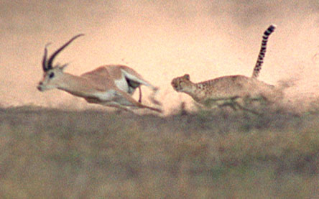
Introduction to animals
What is an Animal?
Copyright cmassengale

Slide 2
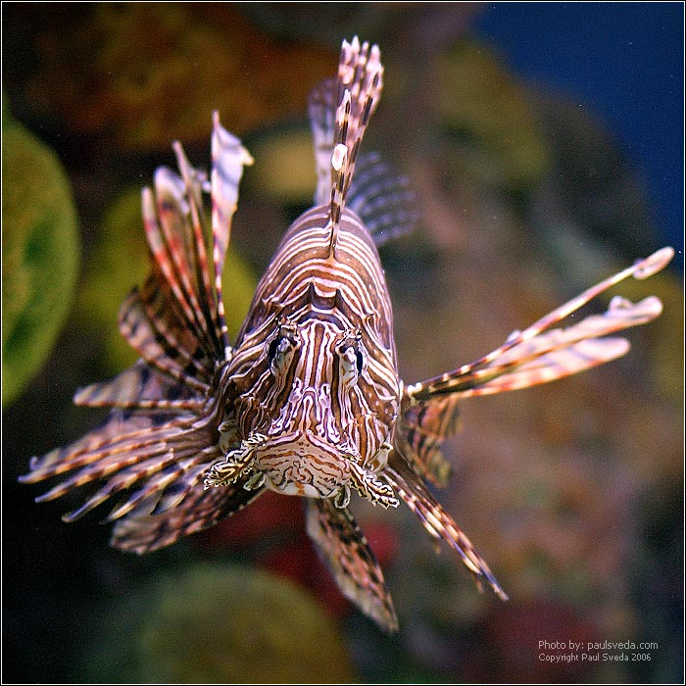
Traits

Slide 3
Characteristics of Animals
All multicellular
Eukaryotes (cells with nucleus & organelles)
Ingestive heterotrophs (take in food and internally digest it)
Store food reserves as glycogen

Slide 4
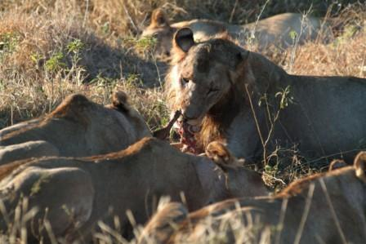
Lions Feeding (Ingestion)

Slide 5
Support Systems
Have some type of skeletal support
Endoskeleton inside and made of cartilage &/or bone
Exoskeletons found in arthropods
Cover the outside of the body
Limit size
Must be molted making animal vulnerable to predators

Slide 6
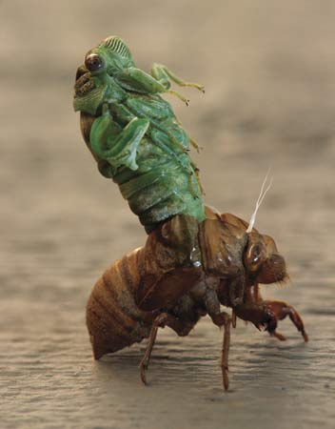
Cicada Molting Exoskeleton

Slide 7
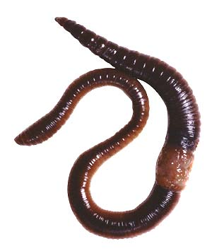
Support Systems
Worms and echinoderms (starfish) have fluid-filled internal cavities giving them support
Called hydrostatic skeletons

Slide 8
Movement
Animals such as sponges may be sessile (attached & non-moving)
Animals that move very little are said to be sedentary (clam)
Animals that can move are motile
Have muscular tissue to provide energy for movement

Slide 9
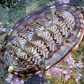
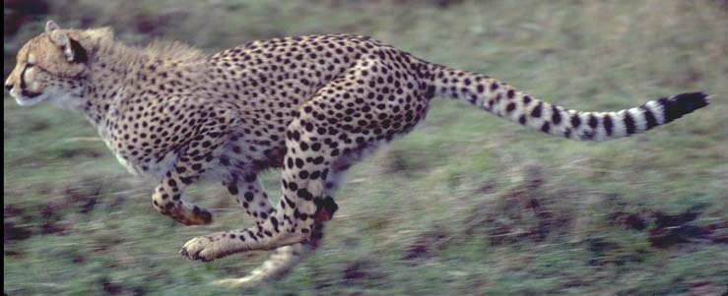
SESSILE
SEDENTARY
Chiton
Sponge
MOTILE
Cheetah

Slide 10
Reproduction in Animals
All animals are capable of sexual reproduction
Some animals like sponges and earthworms are hermaphrodites producing both eggs and sperm
Hermaphrodites may exchange sperm and DO NOT fertilize their own eggs

Slide 11
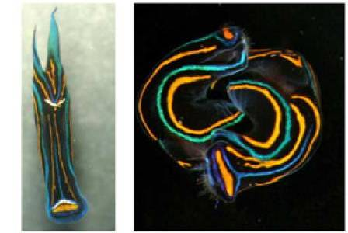
Leeches Exchange Sperm During Mating
leech
Mating

Slide 12
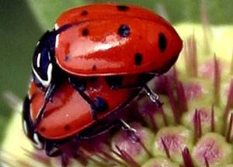
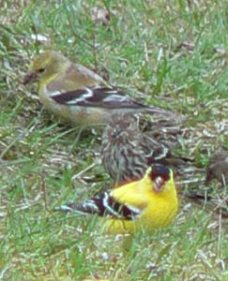
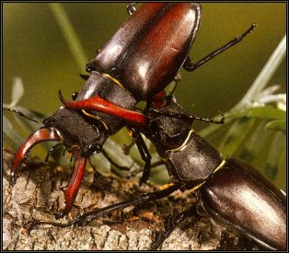
Female
Beetles Mating
Young
Courtship
Male
Mating and Mating Behaviors

Slide 13
Levels of Organization
Sponges are the ONLY animals that have just the cellular level
All other animals show these levels – cell, tissue, organ, and system
Cells may specialize (take on different shapes and functions)
Cells are held together by cell junctions to form tissues

Slide 14
Atom
Molecule or compound
Organelle
Levels of Organization
CELL
Tissue
Life begins
Organ
Organ system
Organism

Slide 15
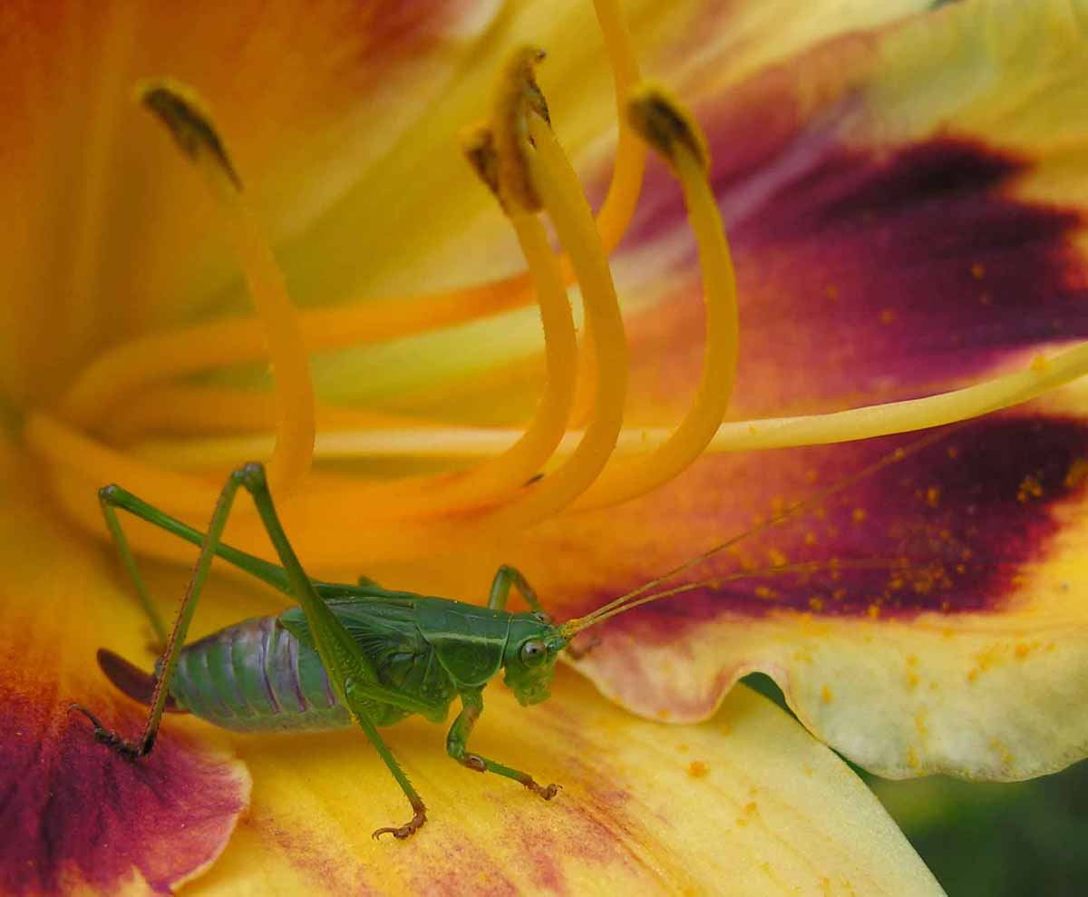
Invertebrate groups

Slide 16
Characteristics of Invertebrates
Simplest animals
Contain the greatest number of different species
Most are aquatic (found in water)
Do NOT have a backbone
Includes sponges, cnidarians, flatworms, roundworms, annelids, mollusks, arthropods, and echinoderms

Slide 17
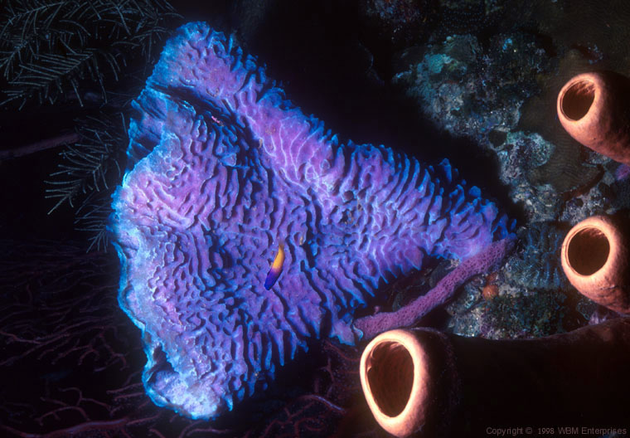
Sponge - Porifera
Osculum of Sponge

Slide 18
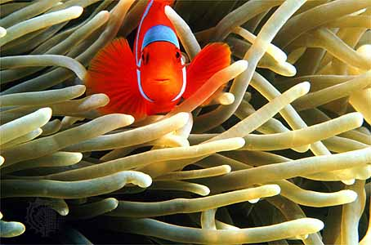
Sea Anemone - Cnidaria
Tentacles of Sea Anemone

Slide 19
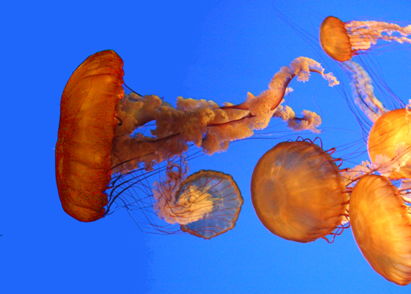
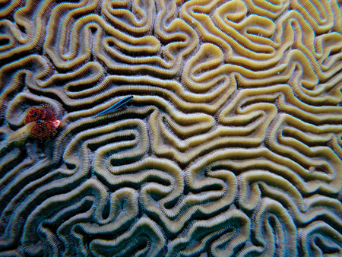
More Cnidarians
Brain Coral
Red jellyfish

Slide 20
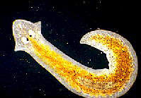
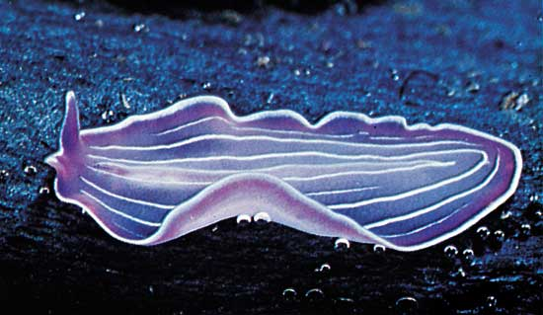
Flatworms - Platyhelminthes
Marine Flatworm
Planarian

Slide 21
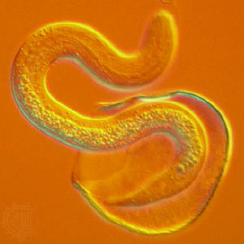
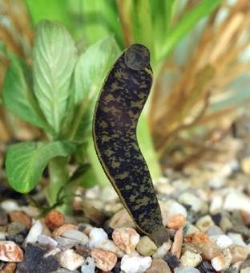
Roundworms (Nematoda) and Segmented Worms (Annelida)
Nematode
Leech (segmented worm)

Slide 22
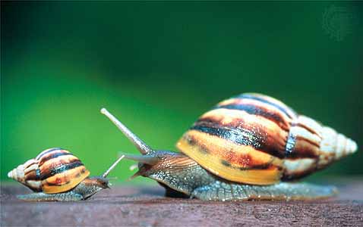
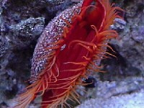
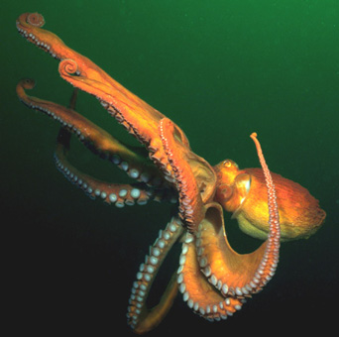
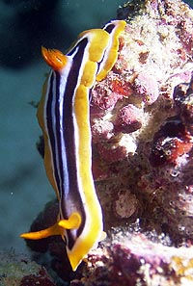
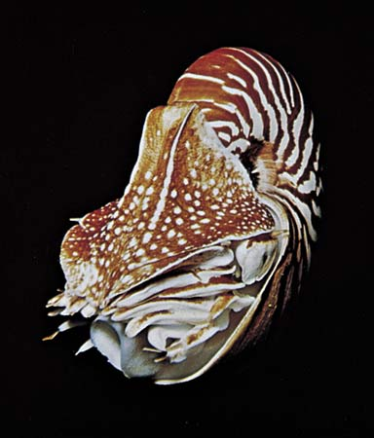
Mollusca (With and Without Shells)
snail
scallop
nudibranch
octopus
nautilus

Slide 23
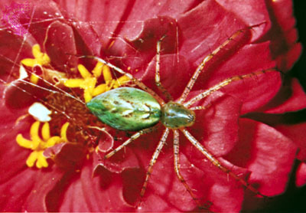
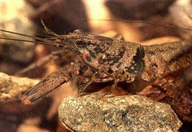
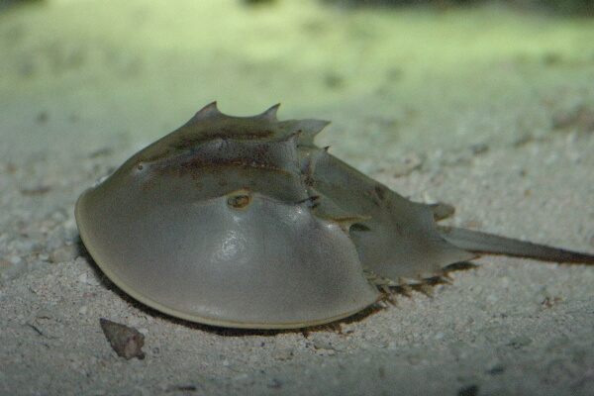
Arthropoda (insects, spiders, crustaceans, horseshoe crab)
spider
crayfish
Horseshoe crab
Dung beetle

Slide 24
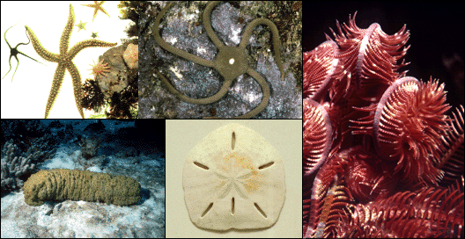
Echinoderms
starfish
Sea fan (crinoid)
Brittle star
Sand dollar
Sea cucumber

Slide 25
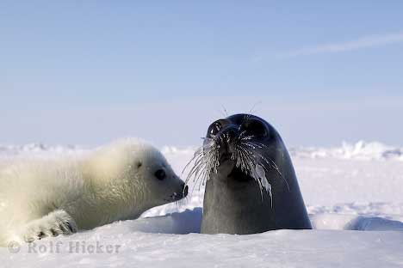
Vertebrate Groups

Slide 26
Characteristics of Vertebrates
More complex animals
Most have a backbone made up of individual bones called vertebrae
From simplest to most complex, the phylum includes: fish, amphibians, reptiles, birds, and mammals

Slide 27
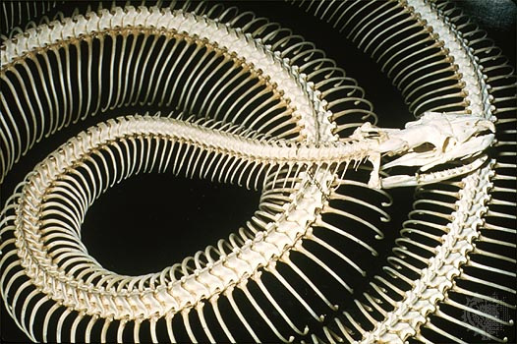
Vertebrate Backbone

Slide 28
Vertebrata
Vertebrates have endoskeletons (internal)
Some vertebrates have skeletons of cartilage (sharks, rays, and skates)
Other vertebrates have skeletons of bone and cartilage (reptiles, birds, & mammals)

Slide 29
Bone & Cartilage in Fetus

Slide 30
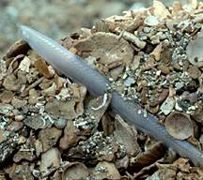
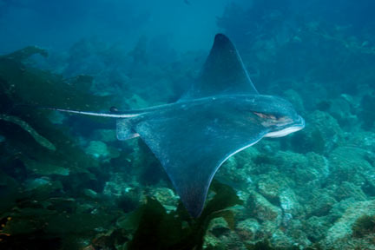
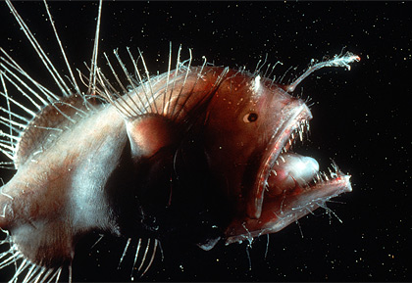
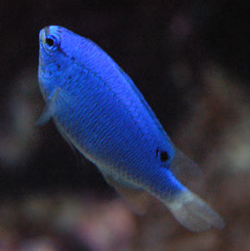
Fish
lancelet
ray
damselfish
anglerfish

Slide 31
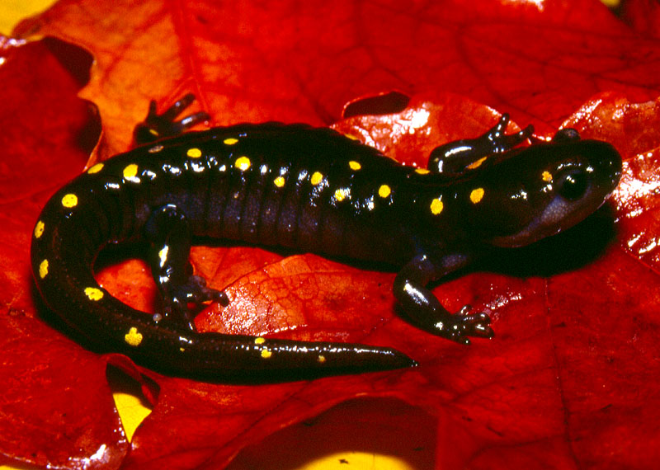
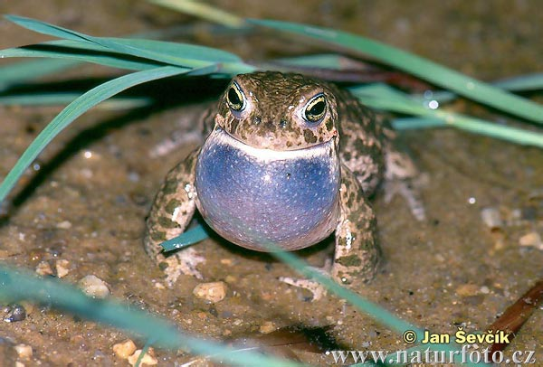
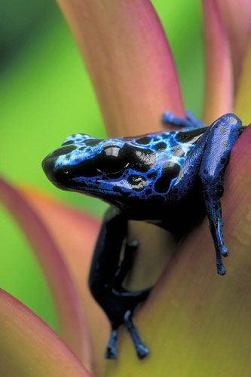
Amphibia
salamander
toad
frog
newt

Slide 32
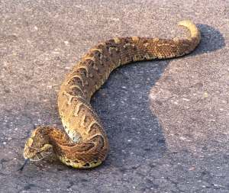
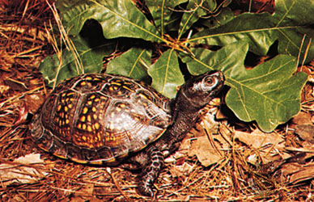
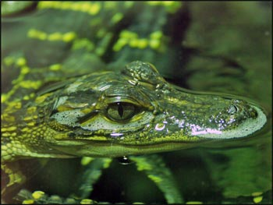
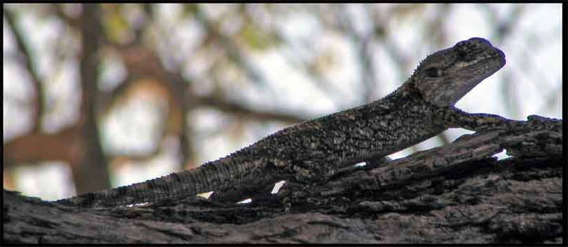
Reptilia
Turtle
Snake
Lizard
Alligator

Slide 33
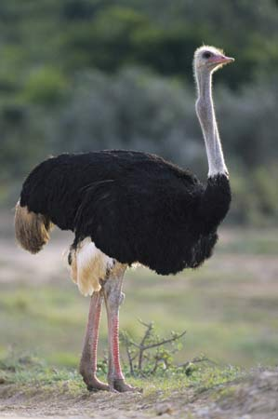
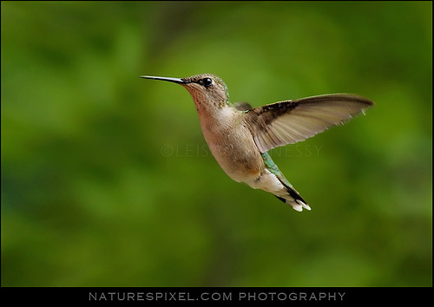
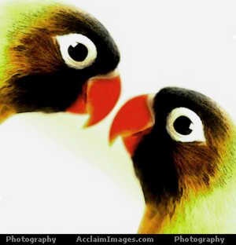
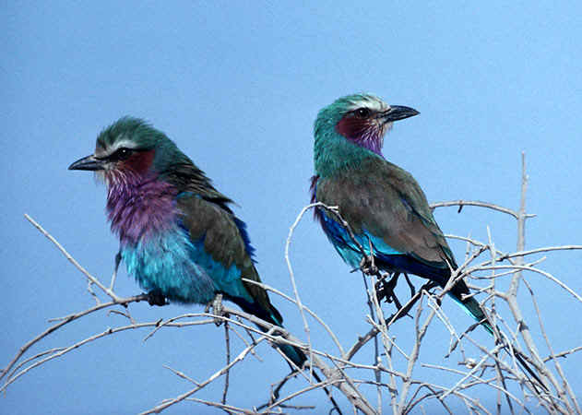
Birds - Aves
hummingbird
ostrich
lovebirds

Slide 34
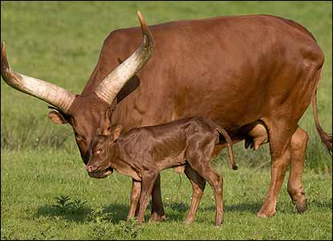
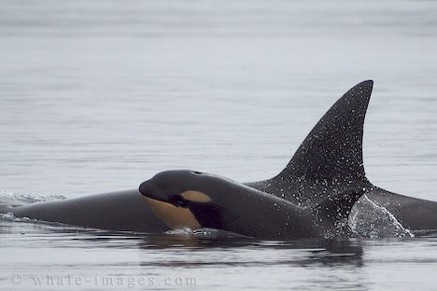
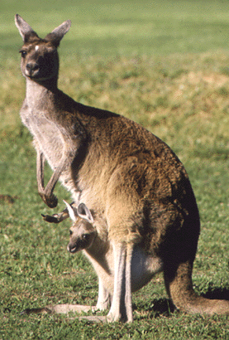
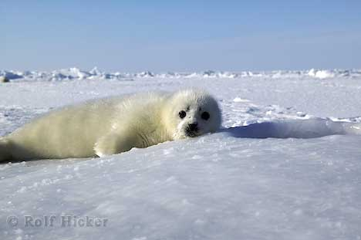
Mammalia

Slide 35
Body Areas

Slide 36
Surfaces
Dorsal – back or upper surface
Ventral – belly or lower surface
Anterior – head or front end
Posterior – tail or hind end opposite the head

Slide 37
Surfaces (Most Animals)
DORSAL
POSTERIOR
ANTERIOR
VENTRAL

Slide 38
Symmetry

Slide 39
Body Symmetry

Slide 40
Body Symmetry
Symmetry is the arrangement of body parts around a central plane or axis
Asymmetry occurs when the body can’t be divided into similar sections (sponges)

Slide 41
Body Symmetry
Radial symmetry occurs when body parts are arranged around a central point like spokes on a wheel (echinoderms)
Most animals with radial symmetry are sessile (attached) or sedentary (move very little)

Slide 43
Body Symmetry
Bilateral symmetry occurs when animals can be divided into equal halves along a single plane
Organisms will have right and left sides that are mirror images of each other
More complex type of symmetry

Slide 44
Body Symmetry
Animals with bilateral symmetry are usually motile
Animals have an anterior and posterior ends
Show cephalization (concentration of sensory organs on the head or anterior end)

Slide 46
Segmentation

Slide 47
Segmentation
Occurs whenever animal bodies are divided into repeating units or segments
Found in more complex animals
Earthworms show external segmentation
Humans show internal segmentation (backbone)
Segments may fuse (cephalothorax)

Slide 48
Segmentation
cephalothorax

Slide 49
Tissues

Slide 50
Body Layers
Sponges have NO tissues or organs, only specialized cells
Cnidarians like jellyfish & coral have only two body layers & one body opening (mouth/anus) into gastrovascular cavity
Cnidarians have outer epidermis & inner gastrodermis with jelly-like mesoglea between the layers

Slide 54
Metamorphosis
COMPLETE
INCOMPLETE

Slide 56
Animal Systems

Slide 57
Support Systems
Spongin & spicules (sponges)
Limestone cases (corals)
Exoskeletons of Chitin (arthropods)
Limits size
Must be shed or molted to grow
Animal vulnerable to predators during molting

Slide 58
Support Systems
Hydrostatic skeleton – fluid filled body cavity (worms)
Inner Calcium plates or Test (echinoderms)
Bone and/or cartilage endoskeleton (vertebrates)

Slide 59
Exoskeletons Must Be Molted

Slide 60
Endoskeletons Grow with the Animal

Slide 61
Digestive Systems
All animals are ingestive heterotrophs
Choanocytes (specialized cells) capture & digest food for sponges
Gastrovascular cavity with one opening in cnidarians and flatworms for food to enter & leave; called two-way digestive system

Slide 62
Gastrovascular Cavity with Mouth Only (Cnidarians)

Slide 63
Two-Way Digestion

Slide 64
Digestive Systems
Animals with a one-way digestive system have a mouth and an anus
Food enters the mouth, continues in one direction through the digestive tract, and wastes leave through the anus
Includes annelids, arthropods, & vertebrates

Slide 65
One-Way Digestion
Mouth
anus

Slide 66
Circulatory Systems
Transports oxygen & nutrients to cells
Carries away wastes & carbon dioxide from cells
Sponges, cnidarians, & flatworms do NOT have circulatory systems

Slide 67
Circulatory Systems
In closed circulation, blood remains inside blood vessels until it reaches cells (annelids & vertebrates)
In open circulation, blood is pumped out of blood vessels to bathe tissues in the body cavity or hemocoel (arthropods & mollusks)

Slide 68
Open Circulation
Closed Circulation

Slide 69
Respiratory System
Taking in O2 & releasing CO2
Gases can diffuse across moist surfaces (earthworms)
Gills filter O2 from water (aquatic animals)
Lungs take O2 from air (terrestrial animals)

Slide 70
Skin breather
Gills
Lungs

Slide 71
Nervous System
Coordinates the activities of the animal’s body
Neurons – nerve cells that transmit electrochemical signals
Nerve net - network of neurons, very little coordination
Ganglion – clusters of neurons; may serve as a simple brain
Brain – control center at anterior end

Slide 73
Excretory System
Excretion is the removal of nitrogen wastes from the body
Diffusion is used by simple aquatic animals
Flame cells remove wastes in flatworms

Slide 74
Excretory System
Coiled tubules called nephridia remove nitrogen wastes in arthropods
Terrestrial animals remove wastes with Kidneys
May be paired (most vertebrates)
May be single as in birds

Slide 76
Reproductive System
Reproduction is the process by which organisms make more of their own kind
All animals reproduce by sexual reproduction (produce eggs and sperm)
Some animals also use asexual reproduction creating identical offspring

Slide 77
Types of Animal Asexual Reproduction
Regeneration or Fragmentation is the breaking off of pieces and the re-growth of a new organism
Found in simple animals like Sponges and Flatworms

Slide 78
Budding occurs in hydra whenever a growth on the parent is released
Creates a clone

Slide 79
Parthenogenesis – females produce eggs that develop unfertilized into female organisms
Komodo dragon is an example

Slide 80
Hermaphrodite are animals like earthworms that produce BOTH eggs and sperm
Most hermaphrodites do NOT fertilize their own eggs
Mate to exchange sperm

Slide 81
Fertilization
External – sperm and eggs are released into water where they are fertilized
Internal – sperm and egg are fertilized inside the female animal’s body

