Slide 1
Dominant-Recessive Lab Human Inherited Characteristics

Slide 2
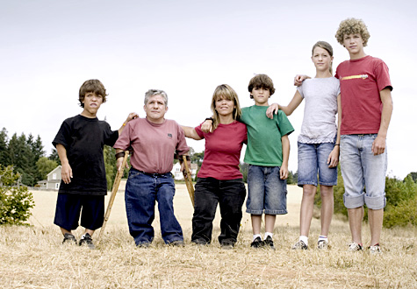
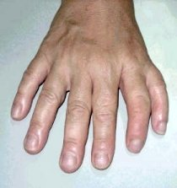
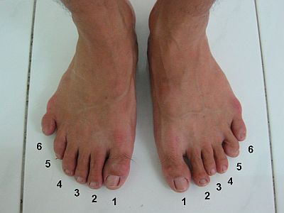

Slide 3
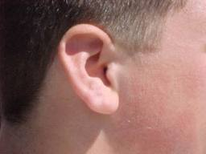
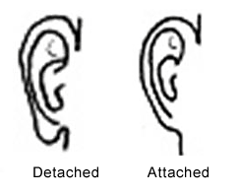
1. Attached ear lobes (e), where the lobe is directly attached to the face are recessive to free ear lobes (E).
Presence of trait: Free
Possible Genotype: EE or Ee
Presence of trait: Attached
Possible Genotype: ee

Slide 4
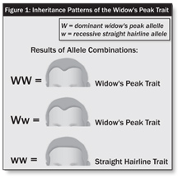
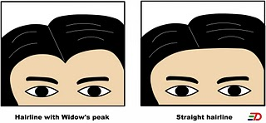
2. Widow’s peak (W), the hair line drops downward on the forehead in a distinct “V” shape, is dominant over a straight or curved hair line (w).
Presence of Trait: Widow’s Peak
Possible Genotype: WW or Ww
Presence of Trait: Straight or Curved
Possible Genotype:
ww

Slide 5
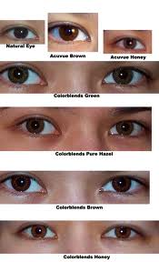
3. Dark eye color (brown- B) is dominant over light eye color (blue-b). Green, hazel, and gray eye color are caused by the blending of several genes (polygenic).
Presence of Trait:
Dark eye color
Possible Genotype:
BB or Bb
Presence of Trait:
Light eye color
Possible Genotype:
bb

Slide 7
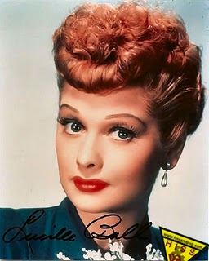
4. Red hair (r) is recessive to non-red hair (R). (This is natural red hair, no colored.)
Presence of trait:
Red Hair
Possible Genotype:
rr
Presence of trait:
Non Red Hair
Possible Genotype:
RR or Rr

Slide 8
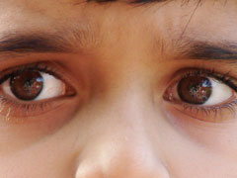
5. Freckles (F) on the face are dominant over having no freckles (f).
Presence of trait:
Freckles
Possible Genotype:
FF or Ff
Presence of trait:
No Freckles
Possible Genotype:
ff

Slide 9
6. In interlocking fingers, as the hands are grasped together, the left thumb on top (L) is dominant over the right thumb being on top (l).
Presence of trait:
Left thumb
Possible genotype:
LL or Ll
Presence of trait:
Right thumb
Possible genotype:
ll

Slide 10
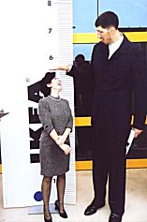
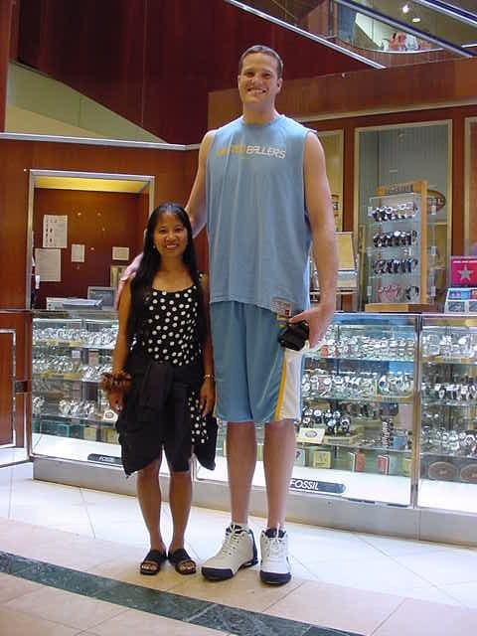
7. Stature in humans is polygenic. But short stature genes (S) tend to be dominant over tall stature genes (s) Use 5 ft 10 in. for boys and 5 ft. 7 in. for girls for tallness.
Presence of trait:
Tall
Possible Genotype:
ss
Presence of trait:
Short
Possible Genotype:
SS or Ss

Slide 12
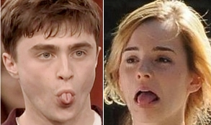
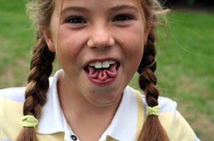
8. The ability to roll the tongue (T) into a “U” shape when extended from the mouth is dominant over the inability to roll the tongue (t).
Presence of trait:
Tongue roller
Possible Genotype:
TT or Tt
Presence of trait:
Non-Roller
Possible Genotype:
tt

Slide 13
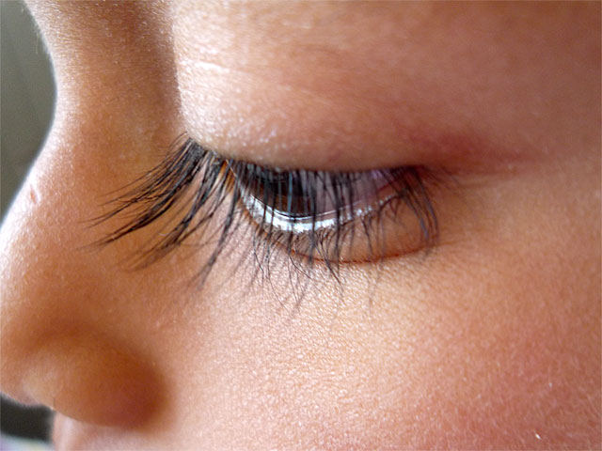
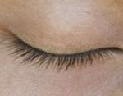
9. Long eyelashes (L) are dominant over having short eyelashes (l). Long eyelashes are 3/8” or longer.
Presence of trait:
Long Eyelashes
Possible Genotype:
LL or Ll
Presence of trait:
Short Eyelashes
Possible Genotype:
ll

Slide 14
Monster Eyelashes

Slide 15
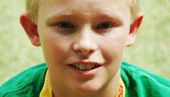
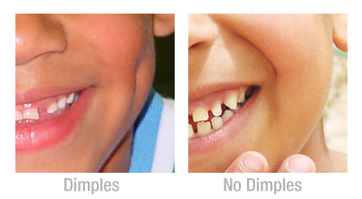
10. Dimples in the cheek (D) are dominant over having no dimples in the cheek. Having one in either side or the other is dominant.
Presence of trait:
Dimples
Possible Genotype:
DD or Dd
Presence of trait:
No Dimples
Possible Genotype:
dd

Slide 16
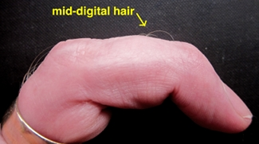
11. The presence of mid-digital hair growth (M) on the second joint of the finger is dominant over the absence of this hair (m).
Presence of trait:
Hair
Possible Genotype:
MM or Mm
Presence of trait:
No Hair
Possible Genotype:
mm

Slide 17
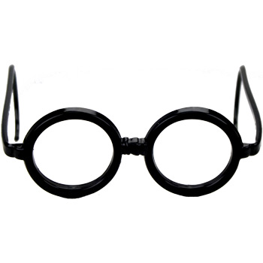
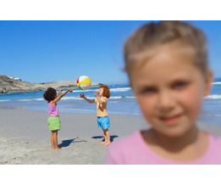
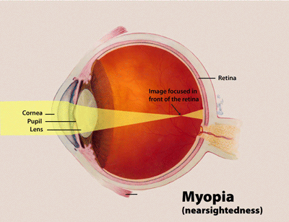
12. Nearsightedness and farsightedness (V) are dominant over normal vision (20/20) (v).
Presence of trait:
Near/far sighted
Possible Genotype:
VV or Vv
Presence of trait:
Normal Vision
Possible Genotype:
vv

Slide 18
13. Having a bent little finger (B), where the last joint of the little finger is bent inward towards the fourth, is dominant over a straight little finger (b).
Presence of trait:
Bent Little Finger
Possible Genotype:
BB or Bb
Presence of trait:
No Bent Finger
Possible Genotype:
bb

Slide 19
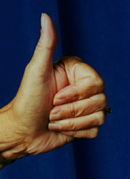
14. The hitch-hiker’s thumb (h), ability to bend the thumb back at a 45 degree angle is recessive to the straight thumb (H).
Presence of trait:
Hitch-hiker’s
Possible Genotype:
hh
Presence of trait:
Straight thumb
Possible Genotype:
HH or Hh

Slide 20
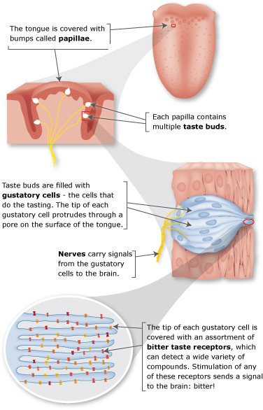
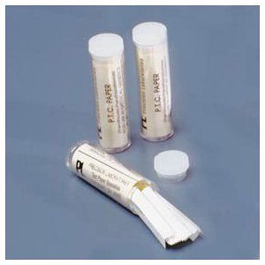
15. The taster gene for PTC (T), is dominant over the non-taster gene (t).
Presence of trait:
Taster gene
Possible Genotype:
TT or Tt
Presence of trait:
Non taster
Possible Genotype:
tt

